Slide 1


An introduction to macroeconomic thinking
Professor William Mitchell
University of Newcastle, Australia
University of Helsinki, Finland

Slide 2

Chapters 1 to 3

Slide 3
Takeaway from today …
Understanding the difference between macroeconomics and microeconomics.
Understanding fallacy of composition.
Understanding basic macroeconomic relations.
What a macroeconomic theory has to explain.
Understanding the difference between a financial and real resource constraint on government spending.

Slide 4
Two economic views of the world …
Microeconomics.
Macroeconomics.
Notes:
The Economy is an extremely complex abstraction.
Concerns aspects of human behavior (within society).
It is not just the study of business, or consumer choice.
It is ‘embedded’ in the greater social and cultural sphere.

Slide 5
The orthodox neoclassical micro approach …
Notes:
Scarcity – unlimited wants finite resources – so we get the idea of budget constraints entereing.
Individual – class concepts irrelevant.
Greed drives optimal outcomes if markets are free, and prices are flexible.
Market is the invisible hand.
Income distribution fair – marginal productivity theory.
Unemployment - an individual problem (lassitude, lack of skills, etc) rather than a systemic problem (lack of jobs).
Choice-theoretic – labour-leisure.
Role of state minimal – to ensure ‘market’ works – assignment of property rights:
Must retrench welfare states.
Privatisation.
Deregulation of financial and labour markets.
Other institutions, such as trade unions are considered to market imperfections and transitory social elements.

Slide 6
The Keynesian-Institutionalist-MMT approach …
Notes:
Economics is the study of the social creation and social distribution of society's resources.
There is no ‘natural’ human behavior.
We are shaped by institutions, culture, history and society.
Many decisions are not ‘rational’.
We are group-oriented – demonstration effects.
Decision-making in face of endemic uncertainty.
Power, discrimination, prejudice, segregation all matter.
Income distribution reflects power.
Capitalism is crisis-prone - significant role for government.

Slide 7
What is distinctive about macroeconomics?
Notes:
Micro focuses on individual consumers and firms.
Macroeconomics is a distinctive area of study.
Macro adopts an economy-wide perspective.
Focuses on GDP, employment, unemployment, overall price level (inflation), international trade and finance.
Became a discipline in its own right in the 1930s.
Why?
Neoclassical era considered macro to be a just a summation of individual maximising behaviour.
Aggregation problem.
Representative agent fudge.

Slide 8
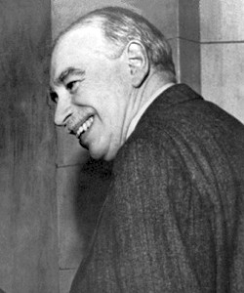
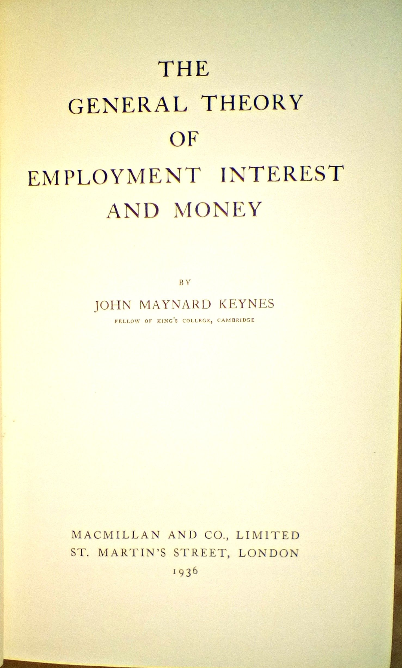
Mainstream macro fails because of the fallacy of composition .
Notes:
What is true of individuals is (usually) not true for society.
The Paradox of Thrift was known as far back as the early C18, when Bernard Mandeville published his social commentary, The Fable of the Bees.
But the importance of this fallacy became apparent during the Great Depression of the 1930s, and, led to the establishment of macroeconomics as a separate branch of economics.
At the time, the dominant neo-classical view was, that if you understood individual consumer or firm decision-making, which was the realm of microeconomics, then you could apply that same logic at the aggregate level.
Some economists like Karl Marx knew that reasoning was flawed, but it wasn’t really until the 1930s, and the publication of John Maynard Keynes’ General Theory of Employment, Interest and Money in 1936, that the shift away from the dominant view occurred and a better understanding of macroeconomic thinking became more widespread.

Slide 9



Notes:
We have all been to a sporting event or a concert where everybody is seated and enjoying a good view of the action?
Then someone stands up to get a better view for themselves. (CLICK)
For the time, while everyone else is seated, the individual who stands up gains a better view.

Slide 10

Notes:
But if all people stood up, they would not gain a better view. (CLICK)
That is what the fallacy of composition is about.
It is an error in logic, that arises when we claim, erroneously, that something, which is true at the individual level, is also true at the aggregate level.
How does this apply to macroeconomics?

Slide 11



Paradox of Thrift
Notes:
Here is a classic example. Take an individual person who has been working too hard. (CLICK)
They get the bright idea, that if they increase the rate they save from their income, they will be able to accumulate the funds necessary to have a nice holiday.
If they remain sufficiently disciplined, their strategy will be successful. (CLICK)
But what would happen, if everybody decided to do the same thing?
In macroeconomics, a basic rule is that spending equals output equals incomes. Why? It is because the economy responds to increased spending by increasing output, which, in turn, stimulates employment and provides incomes.
When the individual increases their saving by withdrawing some of their spending on consumption goods, the impact on the overall economy and on overall income generation would be small.
But if everyone adopted the same goal, at the same time, then total spending would fall significantly, which would reduce sales. This would lead to lower output and employment and total income in the economy would decline.
Total saving is what is left over after households have consumed a proportion of their incomes. Consumption expenditure rises and falls with GDP (or national income). Total saving is thus some proportion of total income. As a result, the fall in national income leads to a fall in total saving even though everyone is trying to increase their saving ratio. The macro effect overwhelms the individual endeavour. (CLICK)
This example of a compositional fallacy was called the Paradox of Thrift. If everyone tries to save more, the economy ends up saving less overall.

Slide 12






Wages as a cost
Small Firm
Wages
Sales
Employment
Few Workers
Costs
Profits
Notes:
Keynes also exposed another area where the dominant neoclassical view fell into compositional fallacy.
The dominant view was that the mass unemployment that had skyrocketed in the early 1930s could only be solved by wage cuts.
Their reasoning was based on their analysis of single firm decision-making. They believed we could generalise from firm-specific analysis.
Say we start with a single firm employing a few workers.
If the firm can persuade its workers to accept lower wages (CLICK), then its labour costs will fall (CLICK).
The loss of income of its workers as a result of the wage cuts, will, in the overall scheme of things, be inconsequential for the total sales of the firm (CLICK).
Accordingly, with lower labour costs and no loss of sales, the firm will increase its profits (CLICK), Neoclassical economists then asserted that the firm would then employ more workers.
Thus, the neoclassical solution to unemployment was to always engineer a wage cut.
This view was disputed by Keynes and others during the Great Depression, when the British Treasury engineered a wage cut for all workers and unemployment became worse.

Slide 13


All Firms
All Workers
Notes:
Keynes asked the question: what would happen if we extended the individual logic to the economy as a whole?
(CLICK)
What would happen if all the firms cut the wages for all workers in an effort to reduce unemployment? (CLICK)
Keynes opposed this solution during the Great Depression of the 1930s as neoclassical economists pressured governments to cut wages.
But this is no idle historical exercise.
The strategy remains a solution advocated by mainstream economists today.
The fallacy relates to the observation by Keynes that wages are both a cost item (supply-side), AND, a source of income (demand-side).
The neoclassical reasoning failed to account for the second characteristic.
Let’s see what this means.

Slide 14
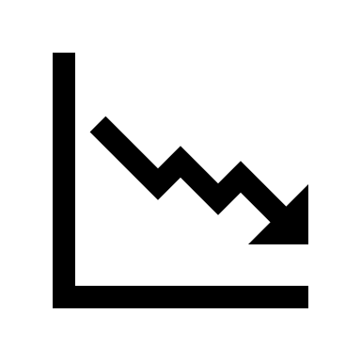

Wages as an income
All Firms
Wages
Sales
Employment
All Workers
Costs
Profits
Unemployment
Notes:
If all firms cut their wages, (CLICK) then labour costs throughout the economy will decline (CLICK).
Neoclassical reasoning was that this would boost profits and businesses would start hiring the unemployed to produce more output and generate even greater profits.
But the dual nature of wages, meant that all workers now had less income, which meant that they could consume less. Consumption expenditure is the largest component of total spending in the economy (around 60 per cent of total).
As workers cut their spending, sales would fall (CLICK), and, profits would start to decline (CLICK).
Firms would note the unsold goods on their shelves and would cut back production and lay off workers. Firms only hire workers if they can sell the extra output produced.
So, the laid off workers would then lose their incomes and the problem would get worse.
Consequently, unemployment starts to rise, and, unless there is a spending stimulus from government, the economy will quickly enter recession.
The point is that the individual logic, even if true, cannot be applied at the aggregate level.
Mass unemployment is always the result of insufficient total spending and can be resolved by governments increasing spending if the non-government sector spending falls. Wages cuts are not a macroeconomic solution.

Slide 15
Thinking in a Macro Way
Notes:
We have to think in system terms when doing macroeconomics.
Basic macroeconomic rule is that - Spending = Output = Income.
Output generates demand for employment.
Cannot have rising income with declining expenditure.
Cutting wages does not increase employment.
Increasing spending increases employment.
Overproduction (crises) is a tendency of the system – realisation crises.

Slide 16
What should theory be able to explain?
Notes:
Requires a theoretical framework for analysis and understanding.
Any macroeconomic theory should at least be consistent with important stylised facts.
What are these facts?

Slide 17
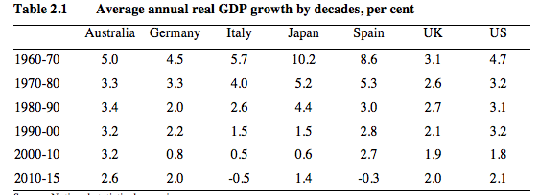
Real GDP growth – downward trend

Slide 18
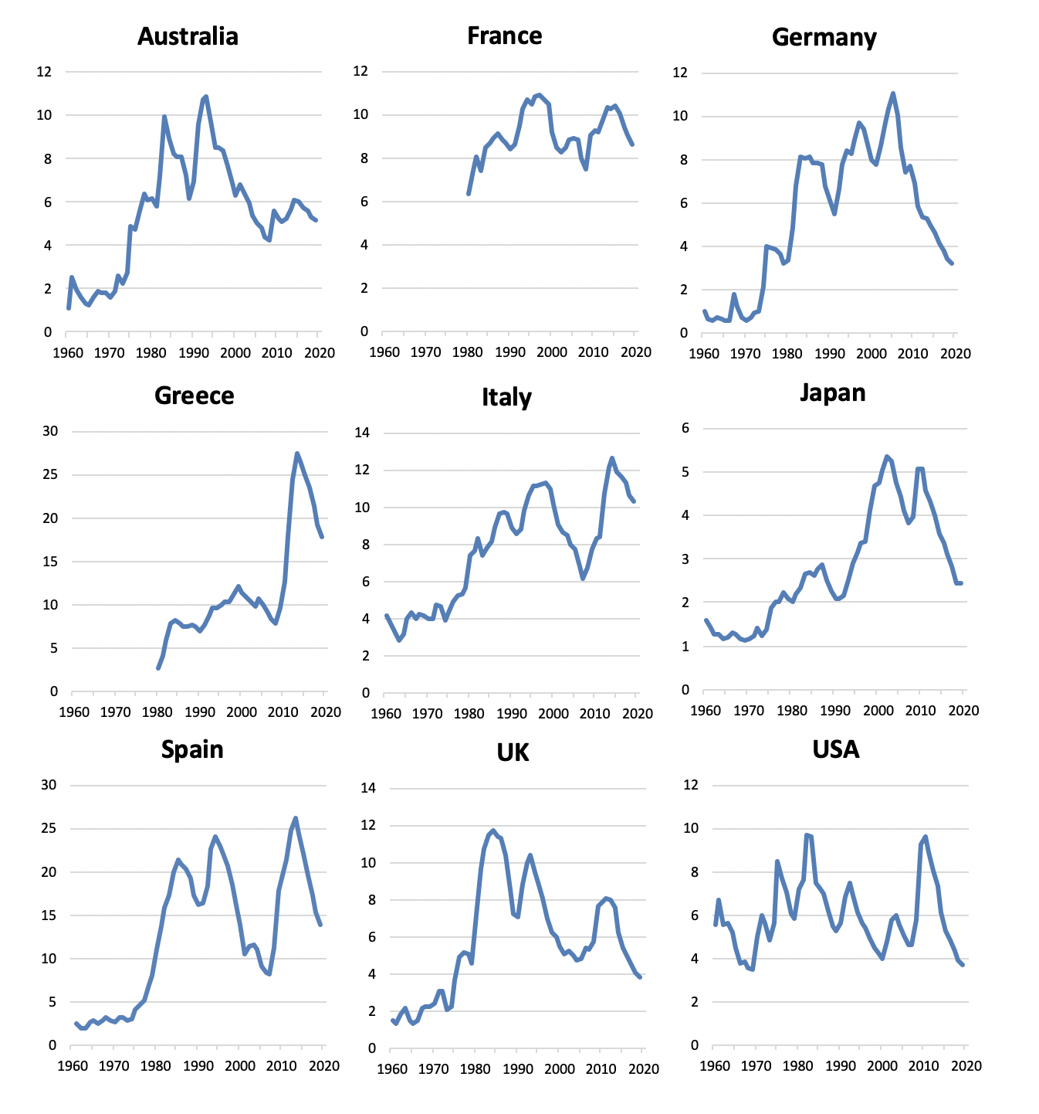
Unemployment rates
Generally trending upwards.
Recent declines.
Eurozone nations higher levels.

Slide 19
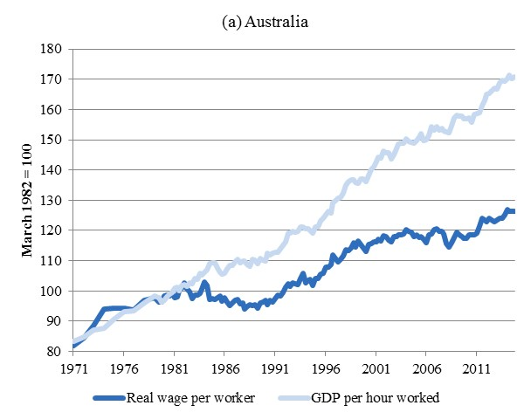
Real wages and productivity – divergence
2020

Slide 20
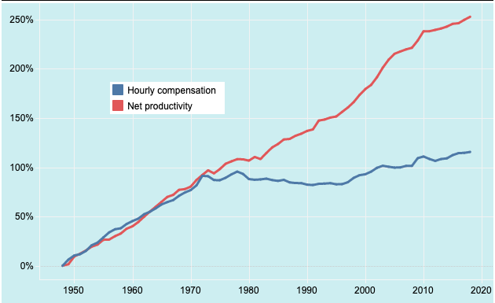
US – Real wages and productivity

Slide 21
Household debt to disposable income - rising

Slide 22
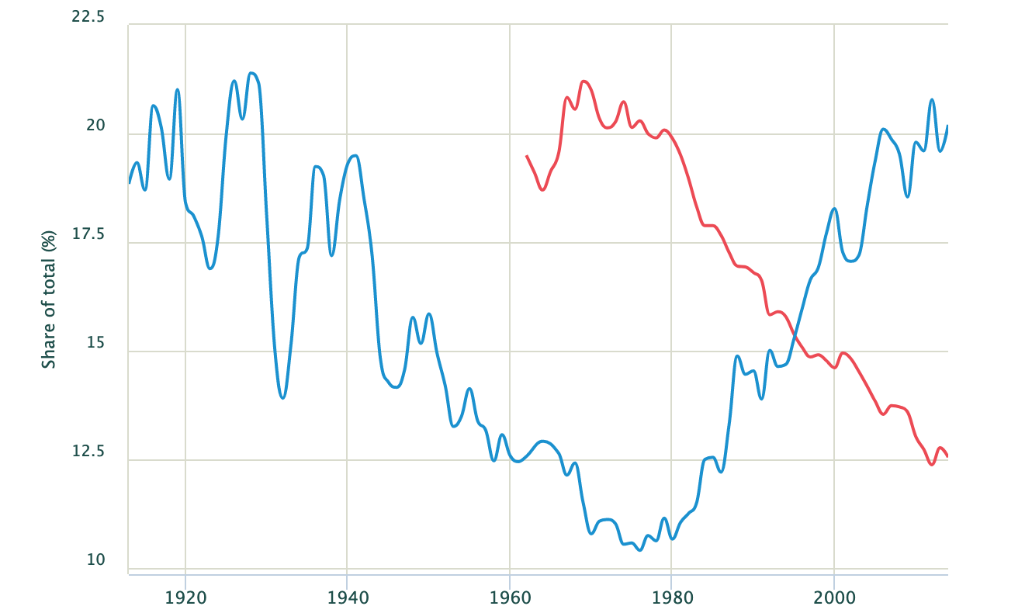
USA – income shares
Top 1%
Bottom 50%

Slide 23
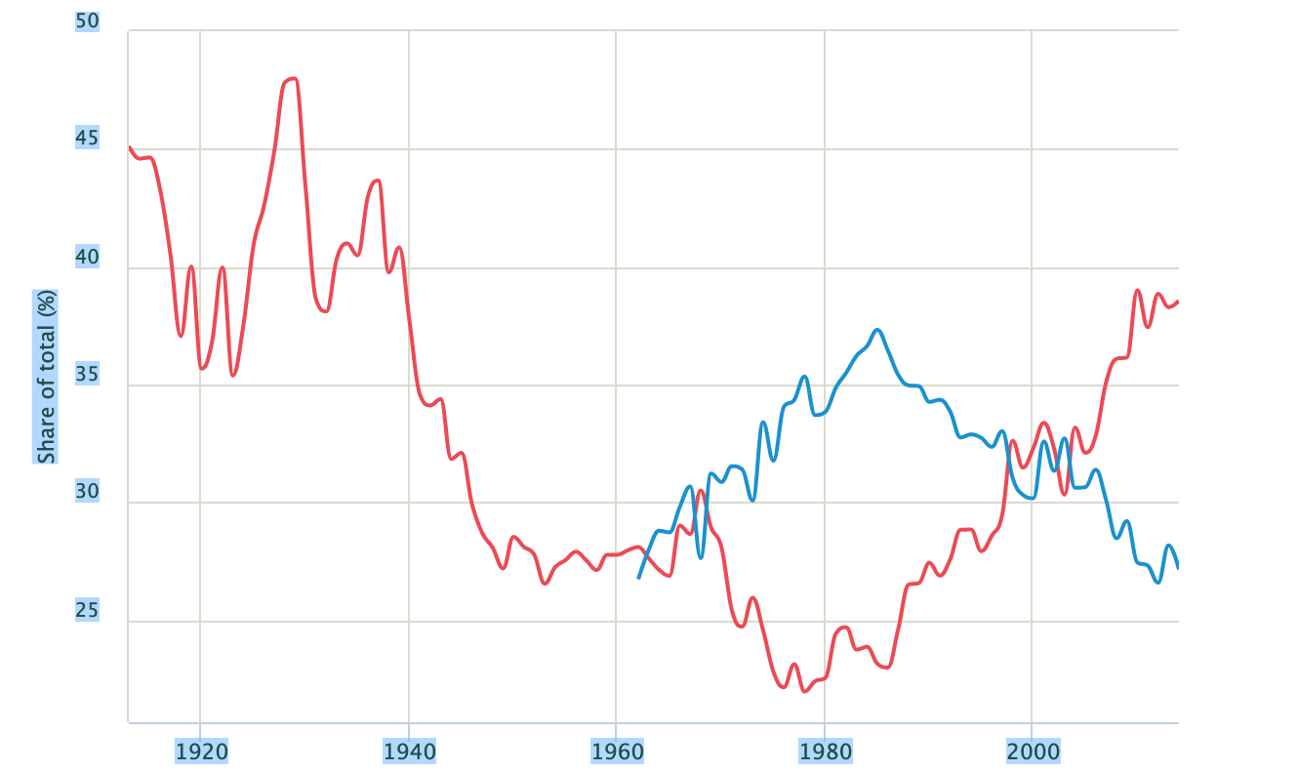
USA – wealth shares
Top 1%
Middle 40%

Slide 24
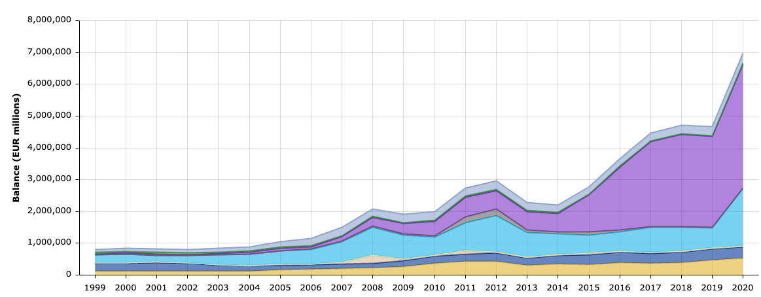
ECB Balance Sheet
QE
Loans to Banks

Slide 25
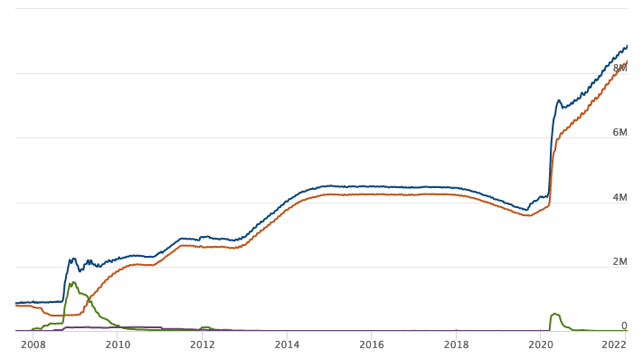
Federal Reserve Balance Sheet

Slide 26
Notes:
Let's now focus on Japan, a large industrial economy that has pushed economic policy parameters to relative extremes since excessive private debt accumulation caused a massive commercial property collapse in 1991.
Japan has provided us with a real-world laboratory to assess the predictive accuracy and explanatory value of different economic approaches.
So consider this sequence of graphs.
The first one is the fiscal deficit since 1980 and public debt in Japan.
The red bars show the surplus in the late 1980s, when government spending was less than taxation. We will learn how this was associated with a massive increase in private sector debt, which led to the crash.
After that the Japanese government has run significant fiscal deficits.
Consult any mainstream macroeconomics textbook and you will find the claim that persistent fiscal deficits push up short-term interest rates because the alleged need to finance higher deficits increases the demand for scarce savings relative to its supply.
These higher interest rates undermine private investment spending (the so-called ‘crowding out’ hypothesis).
Persistent fiscal deficits lead to bond markets demanding increasing yields on government debt.
The rising public debt-to-GDP ratio associated with the persistent fiscal deficits will eventually lead bond markets to withdraw their lending to the government and the government will run out of money.
Persistent fiscal deficits lead to accelerating inflation and potentially hyperinflation, which is highly detrimental to the macroeconomy.
As you will learn, MMT makes no such predictions.

Slide 27
Notes:
Next, we consider the behaviour of the Bank of Japan, the central bank.
We will not yet understand the terms yet, but the first graph shows the money
QE refers to quantitative easing, which involves the Bank of Japan purchasing government debt in exchange for bank reserves, which are held in special accounts the commercial banks keep with the central bank.
Over time, the Bank of Japan has expanded its purchase of JGBs in secondary market (CLICK), which effectively means it has been directly funding fiscal deficits since 2012. A taboo among mainstream economists.
The Bank of Japan now owns 45% of all Japanese government bonds.
This is a case of the government really owning its own debt.
Mainstream economists predicted accelerating inflation from ‘money printing’ and the Bank of Japan losing credibility.
The question then is what has actually happened in response to these policy positions?
Well we can see from the left-panel that inflation has not responded at all to the rapid growth in money in the system.
What about interest rates and bond yields?

Slide 28
Notes:
Obviously bond yields, which are the return the government has to pay to those who buy government debt, have fallen significantly and are now sometimes below zero.
That means that investors are prepared to tie up their liquid assets in 10-year government bonds and get back less than they cost in the first place.
And that is despite Japan having the highest public debt to GDP ratio.
Also the monetary policy interest rate has been close to zero for more than 15 years while the fiscal deficits have been high.
If the mainstream economics approach correctly captured the way the real world operates, then we should have expected to have witnessed rising interest rates, increasing bond yields, and accelerating inflation in Japan, given the persistent fiscal deficits.
None of those impacts have been observed, which casts doubt on the veracity of the mainstream approach to macroeconomics.
As you will learn, MMT can explain all these seemingly curious data events.

Slide 29
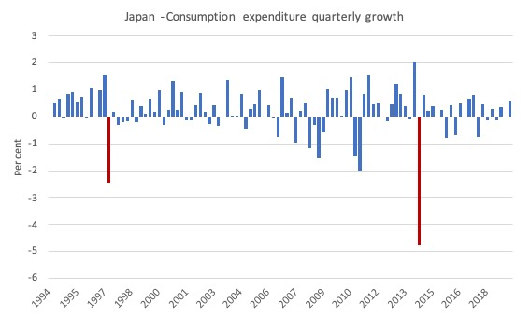
Japan - the sales tax fiasco

Slide 30
Why can’t we just rely on evidence?
Notes:
Observational Equivalence.
Theory often ambiguous:
Wage cuts: costs (supply) versus sales (demand).
Hard to do proper controls - social science.
Kuhn: Scientific Revolutions and Lakatos: Research Programs.
Normal science.
Degenerative paradigms.
Groupthink.

Slide 31
MMT is a new macroeconomic framework …
Notes:
Modern Monetary Theory (MMT) provides the ‘best’ explanation for these stylised facts.
The mainstream economics approach cannot explain the data trends.
So what is MMT?
We will find out in Lecture 4.

Slide 32
Understanding constraints in macroeconomics …

Slide 33
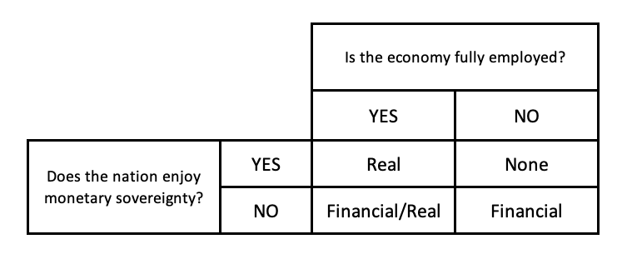
Evaluating the constraints on government spending
MMT
Yes
Yes
Real

Slide 34
Evaluating the constraints on government spending
MMT
No
Yes
None

Slide 35
Evaluating the constraints on government spending
MMT
Yes
No
Financial/Real

Slide 36
Evaluating the constraints on government spending
MMT
No
No
Financial

Slide 37
Evaluating the constraints on government spending
Mainstream Macro
Yes
Not a relevant distinction
Financial/Real

Slide 38
Evaluating the constraints on government spending
MMT
No
Not a relevant distinction
Financial

Slide 39
END OF TALK

