Slide 1


An introduction to basic macroeconomic concepts
Professor William Mitchell
University of Newcastle, Australia
University of Helsinki, Finland

Slide 2

Chapters 1 to 7

Slide 3

Notes:
This waterfall and river are examples of flows.
We measure flows in terms of some metric measured over time.
For example, we could measure the volume of water that had flowed past some point on the river over a course of a day.
In macroeconomics, there are several key FLOW variables and understanding their nature helps us achieve a better understanding of consequences of policy interventions.

Slide 4





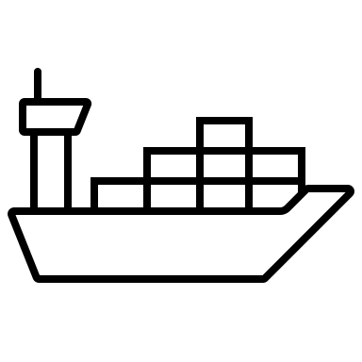







Flows of currency
per month
per week
per year
Notes:
The National Accounts measures flows of expenditure that sum to GDP.
So household consumption expenditure (CLICK), business investment expenditure (CLICK), government spending (CLICK), income from exports that flows into the country (CLICK) and spending on imports that flow out of the country (CLICK) are all flows of dollars measured over some period.
A flow is measured with reference to a time period - a month, a quarter, a year or whatever, rather than at a point in time.
We say that real GDP was $x billion over the first quarter, which is the sum of all the expenditure flows during that three-month period.
When you receive your weekly pay (CLICK) it is a flow of dollars - $x per week, or whatever the pay period is.
We always express a flow with respect to some time period over which it is measured, for example, Yen per month (CLICK) or Pounds per year (CLICK).
We will learn that when the government spends it introduces a flow of currency into the non-government sector and when it receives tax revenue a flow of currency is drained from the non-government sector.
The difference, which we call the fiscal balance, is the difference between two flows.

Slide 5
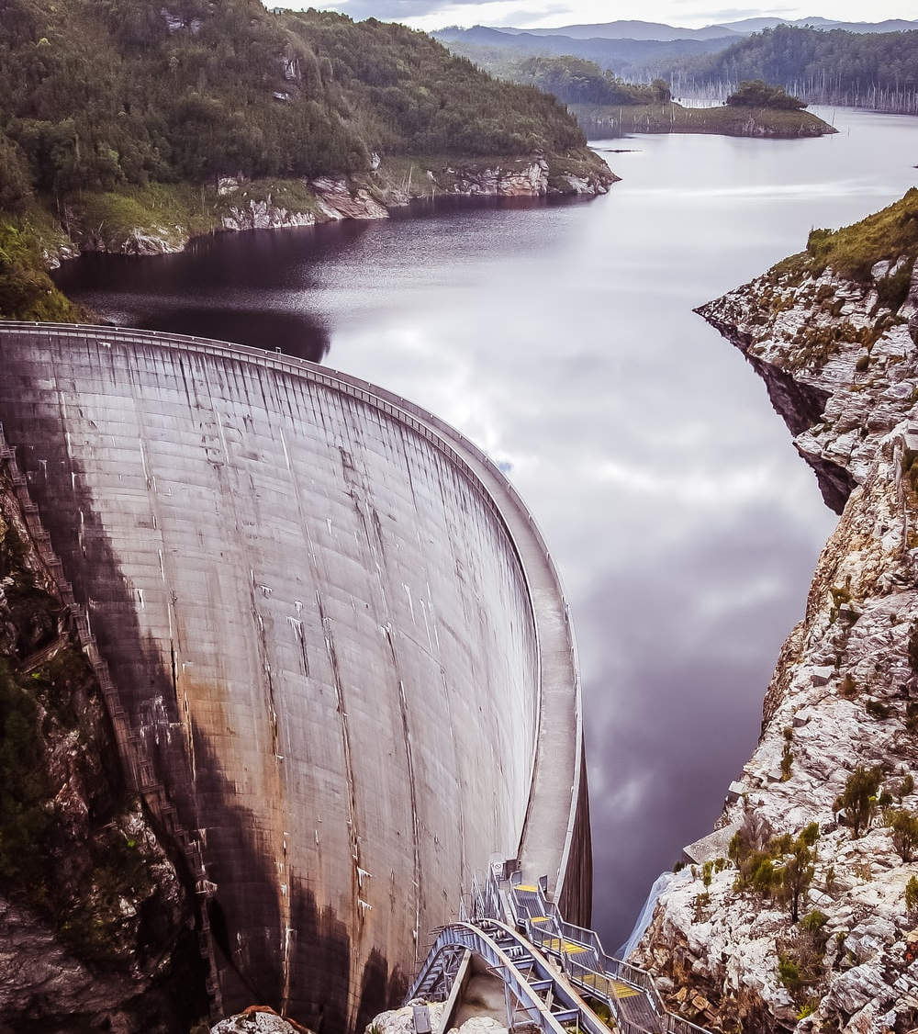
Notes:
This is the Gordon Dam, in the Australian state of Tasmania. It was built as part of a Hydro-electricity project. (CLICK)
It is what we would call a STOCK as we measure it a some volume of water at some point in time.
Private Wealth is another stock concept (CLICK).
You have so much $ value wealth today.
So a STOCK is measured at a point in time.
Examples in macroeconomics include total employment, total unemployment, wealth, government debt outstanding, private debt outstanding.

Slide 6









Wealth
Employment
Unemployment
Debt – private or public
Productive Capital
$100
Notes:
Here are some examples of stocks in economics.
When we accumulate wealth in financial assets we increase our STOCK of wealth (CLICK).
When we take on debt to buy a house we have a stock of outstanding financial liabilities (CLICK).
But stocks can also be real things.
So Employment (CLICK) is a stock as is unemployment (CLICK)
All the productive capital an economy has at its disposal is a stock (CLICK)
Which leads us to another important point – flows feed into stocks.

Slide 7

Notes:
To demonstrate the relationship between flows and stocks here is the famous bathtub example.
We start with a flow of water from the tap with the bath drain plug closed. (CLICK)
The water level or STOCK of water in the bath rises (CLICK) and rises (CLICK).
The stock will stop changing when we turn off the flow (CLICK).
Then after our bath, we pull the drain plug and the water starts to drain out and the stock (level) falls.

Slide 8
Notes:
Eventually, if the IN flow stops and the OUT flow continues, the stock of water will deplete. (CLICK)
Later in the course, we will learn that when the government runs a fiscal deficit (which means its flow of spending into the economy is greater than the flow of taxation out) then financial wealth (a stock) rises in the non-government sector.
However, when the government runs a fiscal surplus it withdraws currency from the economy in net terms and the stock of non-government sector wealth starts to deplete.
Thus, fiscal surpluses destroy financial wealth in the non-government sector.

Slide 9


Flows feed stocks
>
=
Flow
Income
Flow
Spending
Flow
Saving
Stock
Wealth
Notes:
When we receive our pay it is a flow of currency over the pay period. (CLICK)
If we do not consume all our pay (CLICK) then households are said to be saving.
Saving is the difference between two FLOWS – income and consumption expenditure.
But the flow of SAVING then accumulates into a stock of wealth (CLICK)
And our stock of financial assets (wealth) increases.

Slide 10
<
=
>
Flow of Investment
Flow of Depreciation
time
Capital Stock
Notes:
We previously mentioned that when businesses or government invest in capital infrastructure, we call that a flow.
But the flow accumulates into the stock of capital in the economy in the form of plant, equipment, and public goods.
But as time passes the capital stock deteriorates, or, in economic jargon, depreciates and the stock declines.
Depreciation is considered a flow which reduces the stock of capital.
When the flow of new investment spending is greater than the flow of depreciation (CLICK) the STOCK of capital rises (CLICK).
When the flow of new investment spending is greater than the flow of depreciation (CLICK) the STOCK of capital rises (CLICK).
Finally, when the flow of new investment spending just covers the flow of depreciation (CLICK) the STOCK of capital remains unchanged CLICK).

Slide 11
National accounting …
GDP – market (monetary) value of all final goods and services produced in nation over a given period.
The flow of total expenditure equals total income equals total output.
Spending sectors:
  Private domestic (firms –> invest and households -> consume).
  Government (spending -> current and capital and taxation).
  External Sector (exports and imports, income flows).

Slide 12
Total expenditure = total output = total income
GDP = Y = C + I + G + (X – M)
Y is total output or income.
C is household consumption spending.
I is total private capital formation (aka investment).
G is total government spending.
X is exports and M is imports.

Slide 13
Real and Nominal GDP …
Nominal GDP is based on current market prices.
Real GDP is the value of goods and services produced in the current period, valued at some base year prices – that is, it excludes the effect of inflation.
Real GDP shows how much output growth has occurred.

Slide 14
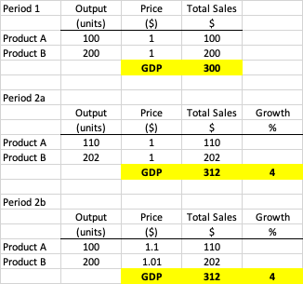

Slide 15
Potential GDP …
Output when all productive resources are ‘fully’ utilised.
Output gaps.
It is unobservable and difficult to measure.
Interaction between real and potential GDP – hysteresis.

Slide 16
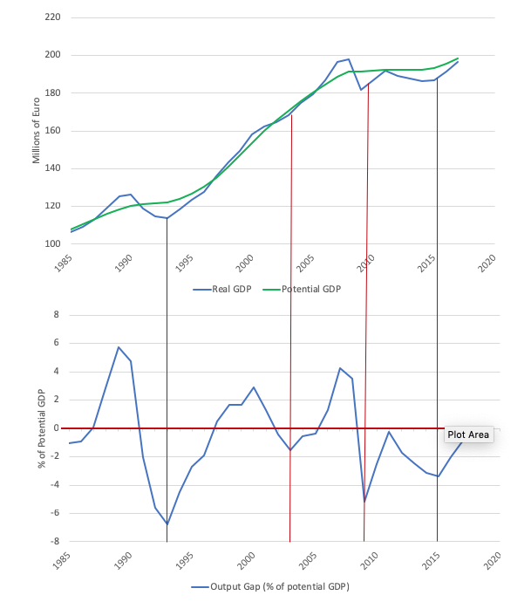
As real GDP declined, Potential GDP also flattened

Slide 17
Problems with GDP as a measure of well-being …
Largely ignores quality of output.
Includes ‘bads’:
  Production that also pollutes (overall impact could be negative).
  Spending to deal with ‘bads’ - clean up environment, health.
  Military spending.
Ignores ‘non-market’ activity
  Housework – gender-biased.
  Ignores value of leisure (unless you spend money on it!).
GDP per capita measures – ignore income distribution – inequality is a rising issue.

Slide 18
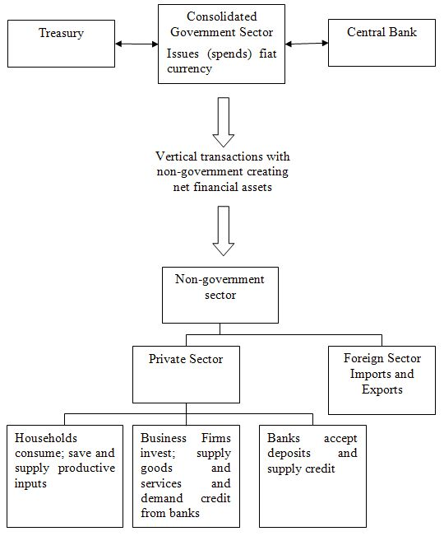

Slide 19



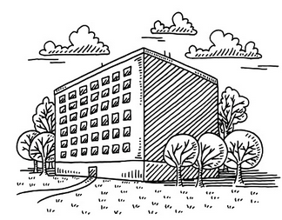
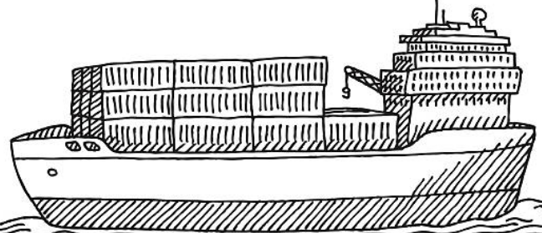
$ Injections
Supply of Productive Inputs
Public Spending
Investment
Public Spending
Exports
Taxes
Government
Total Income $
Disposable Income
Investment
Exports
Households
Financial
Firms
Saving
$ Leakages
Saving
Consumption spending $
Taxes
Imports
Foreign
Imports
Supply of Output (GDP)
Notes:
We start with a simple representation of the economy where we have households and firms. The government is there too but we will abstract from its role at first even though none of this could happen without currency injections from the government.
Households provide productive inputs to firms (CLICK) in exchange for a flow of income (CLICK).
The households are motivated to consume (CLICK) and the firms were willing to produce and hire because they anticipated selling output (GDP) (CLICK).
At this point the spending cycle would be self-sustaining given preferences and GDP would be unchanged from period to period.
Now, households decide to save a proportion of their income (CLICK), which reduces the $s flowing back to firms in the form of demand for goods and services. We call this a LEAKAGE from the expenditure system.
The leakage means that the EQUILIBRIUM is disturbed because some income earned is not recycled back to firms. If nothing further happened, firms would reduce output, lay off workers and GDP would decline as would Total Income.
To restore equilibrium (at the previous level of GDP) some other source of spending has to be INJECTED into the flow. The normal story is that business investment plays this role (CLICK)
As a result total spending is back to where it was and GDP would be unchanged.
The government also spends (CLICK) and this would drive income up and under some circumstances might exhaust the available productive resources. This is considered an INJECTION into the expenditure stream. They can reduce this pressure by draining some private spending capacity through taxes (CLICK) which is a LEAKAGE. Note that total income is now disposable income (Total minus taxes).
Finally, the economy also imports things (we are abstracting from firms importing here to simplify), (CLICK) which then introduces a further leakage which has to be offset by a spending injection, in this case, exports (CLICK).
Note the way we have specifically matched the leakages to injections is stylistic only. In reality, there is no sense that, for example, Saving equals investment, and imports equals exports.
Which is an important point we take up next.
Private domestic (firms –> invest and households -> consume).
2. Government (spending -> current and capital and taxation).
3. External Sector (exports and imports, across border income flows).

Slide 20
Expenditure-Income-Output relationship …
If spending changes so does output and income.
For GDP to remain constant, total leakages = total injections.
  S = I
  S + T = I + G
  S + T + M = I + G + X
Note that these leakages are themselves dependent on the level of income (and hence spending).
Steady-state or equilibrium.

Slide 21
The multiplier process …
INJECTION
Rise in Expenditure
Aggregate Demand Rises
GDP Rises
Employment Rises
Induced Domestic Spending
National Income Rises
Wage and Other Payments
LEAKAGES
Additional Taxes, Saving and Imports

Slide 22
Example: Government spending increases 100
Changes in | GDP | Taxes (T) | Disposable Income | Consumption (C) | Saving (S) | Imports (M) | Total Leakages (T + S + M)
Period 1 | 100.0 | 20.0 | 80.0 | 64.0 | 16.0 | 20.0 | 56.0
Period 2 | 44.0 | 8.8 | 35.2 | 28.2 | 7.0 | 8.8 | 24.6
Period 3 | 19.4 | 3.9 | 15.5 | 12.4 | 3.1 | 3.9 | 10.8
Period 4 | 8.5 | 1.7 | 6.8 | 5.5 | 1.4 | 1.7 | 4.8
Period 5 | 3.7 | 0.7 | 3.0 | 2.4 | 0.6 | 0.7 | 2.1
Period 6 | 1.6 | 0.3 | 1.3 | 1.1 | 0.3 | 0.3 | 0.9
Period 7 | 0.7 | 0.1 | 0.6 | 0.5 | 0.1 | 0.1 | 0.4
Period 8 | 0.3 | 0.1 | 0.3 | 0.2 | 0.1 | 0.1 | 0.2
Period 9 | 0.1 | 0.0 | 0.1 | 0.1 | 0.0 | 0.0 | 0.1
Period 10 | 0.1 | 0.0 | 0.0 | 0.0 | 0.0 | 0.0 | 0.0
Period 11 | 0.0 | 0.0 | 0.0 | 0.0 | 0.0 | 0.0 | 0.0
Period 12 | 0.0 | 0.0 | 0.0 | 0.0 | 0.0 | 0.0 | 0.0
…
Total change | 178.6 | 35.7 | 142.9 | 114.3 | 28.6 | 35.7 | 100.0
Parameters:
MPC | 0.8
Tax rate | 0.2
MPM | 0.2
Multiplier | 1.79
ΔGDP = ΔC - ΔM
ΔC = 64
ΔM = 20
ΔGDP = 44
ΔY_{d} = 80
ΔC = MPC x ΔY_{d}
ΔC = 0.8 x 80
ΔC = 64
ΔGDP = 100
ΔT = tax rate x ΔGDP
ΔT = 0.20 x 100
ΔT = 20
ΔY_{d} = ΔGDP - ΔT = 80

Slide 23
Sectoral accounting balances …
Disposable Income = (GNP – T) – that is total income minus taxes levied by the government.
GNP - T = C + I + G + (X - M) + FNI - T
Now we can assemble the so-called sectoral balances:
(GNP - T – C) - I = (G – T) + (X - M + FNI)
The term (GNP – T – C) is total income less taxes less consumption expenditure which equals household saving.

Slide 24
Sectoral accounting balances …
(GNP - T – C) - I = (G – T) + (X - M + FNI)
Household Saving
Government Fiscal
Balance
Current Account Balance
Overall Private Domestic Saving

Slide 25
Sectoral accounting balances …
Noting (GNP - T – C) = S
(S - I) = (G – T) + (CAB)
Private Domestic Balance
Government Balance
External Balance

Slide 26
Sectoral accounting balances …
(S - I) = (G – T) + (CAB)
Therefore:
[(S - I) – CAB] = (G – T)
Non-government Balance
Government fiscal
Balance
Government fiscal deficit (surplus) = Non-government surplus (deficit)

Slide 27
Sectoral accounting balances …
(S - I) = (G – T) + (CAB)
National income changes maintain this equality.
How?
S rises with Yd.
T rises with GDP.
M (imports) rise with GDP.
Some insights:
  If there is a CAB < 0, then the government must be in deficit for the private domestic sector to save overall.
  If there is a CAB <0, then if the government runs a surplus, the private domestic sector will be increasingly accumulating debt.

Slide 28
Automatic stabilisers …
Consider the government fiscal balance: (G – T).
Cannot be a policy target because it is not controlled by government.
Both spending and tax receipts are dependent on the state of the cycle.
Final fiscal balance is determined by discretionary fiscal policy settings and the spending decisions of the non-government sector.
When economic activity is strong, T rises and G falls which reduces the deficit (other things equal).
When economic activity is weak, T falls and G rises which increases the deficit (without any policy change).
This cyclical effect is what is known as automatic stabilisation.
Structural versus cyclical fiscal balance.

Slide 29
The full employment fiscal deficit condition
What is the desirable fiscal stance of government.
Government should aim to achieve full employment among other things.
We note:
  Yf is full employment income or output levels.
  S(Yf) is the level of saving at full employment income.
  M(Yf) is the imports at that level of income.
  I(Yf) is the investment level at full employment.

Slide 30
The full employment fiscal deficit condition
Sectoral balance expression: (G – T) = (S – I) – (X – M)
Thus, for national income to be stable, the fiscal deficit has to equal the desired overall saving of the private domestic sector (S – I) minus the current account surplus.
The Right-hand expression is overall non-government saving.
But even though a fiscal deficit of that magnitude will stabilise national income it will not necessarily sustain full employment.

Slide 31
The full employment fiscal deficit condition
Accordingly, to sustain full employment the condition for stable national income is written more specifically:
(G – T) = S(Yf) + M(Yf)] – [I(Yf) + X]
If the non-government leakages > injections then for national income to remain stable, there has to be a fiscal deficit (G – T) sufficient to offset that gap in aggregate demand.
Non-govt leakages at full employment
Non-govt injections at full employment

Slide 32
END OF TALK

