Slide 1


Introducing Modern Monetary Theory
Professor William Mitchell
University of Newcastle, Australia
University of Helsinki, Finland

Slide 2
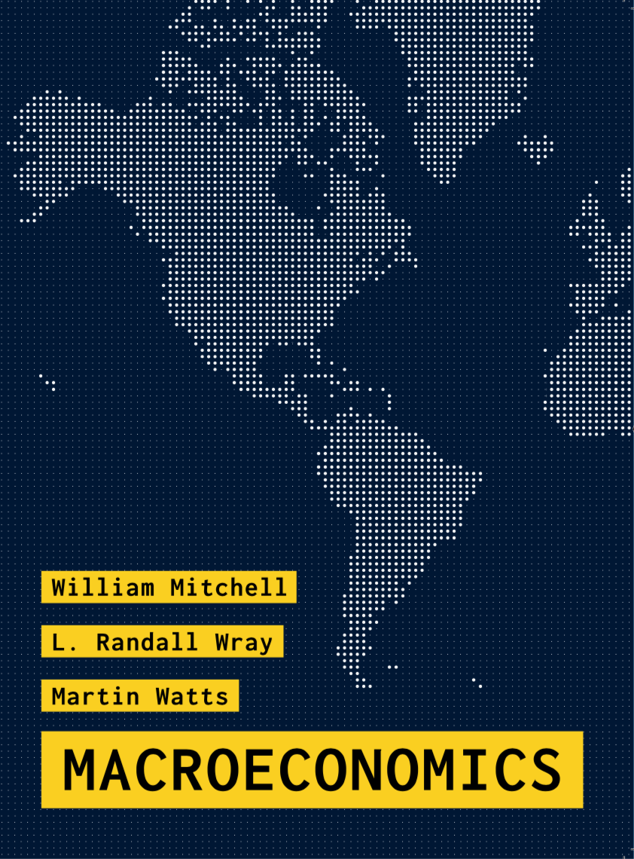
Chapters 9, 10, 20-24 and 31

Slide 3
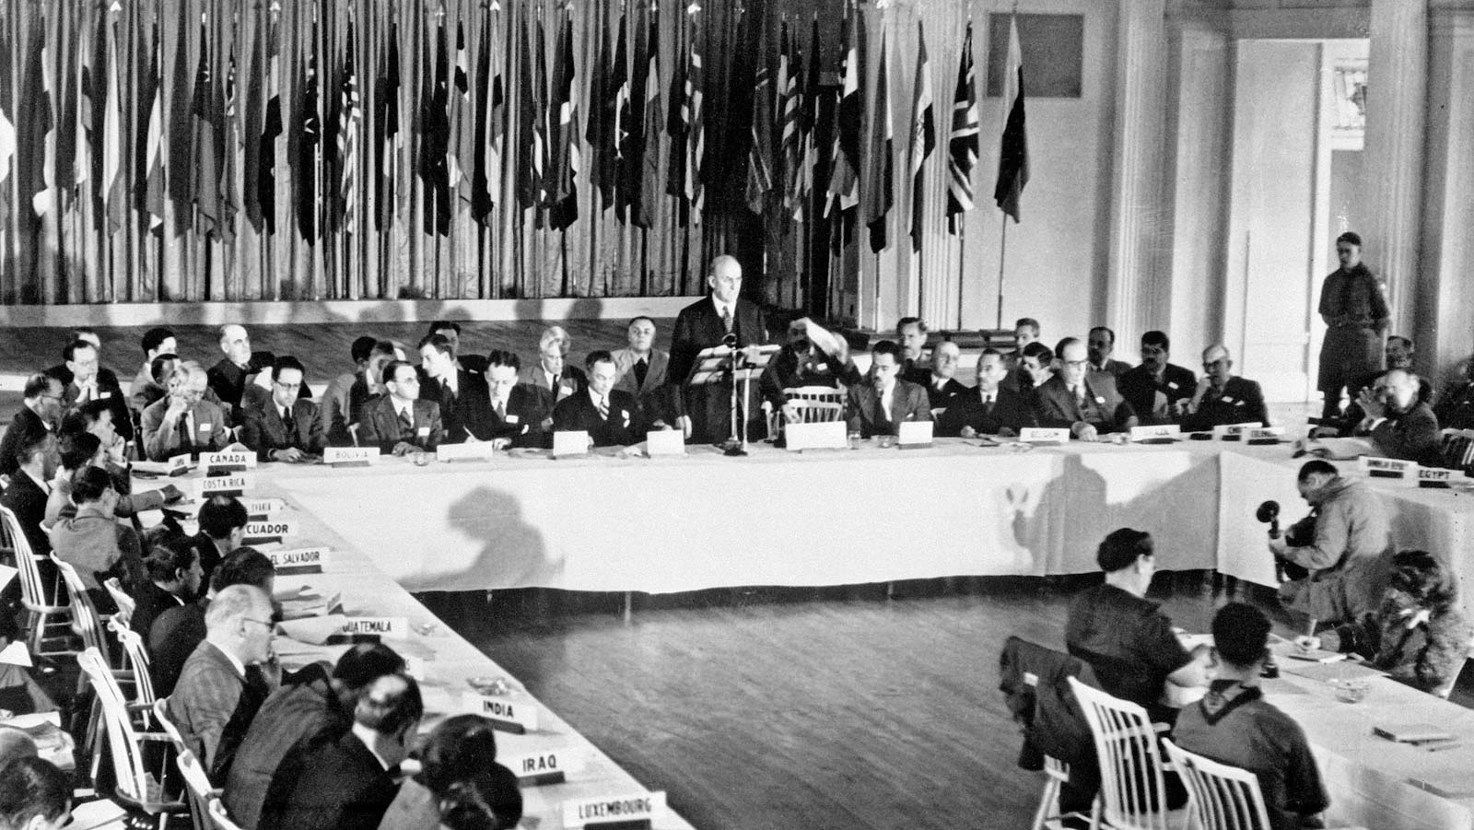
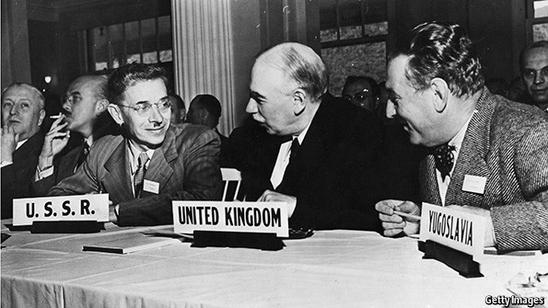
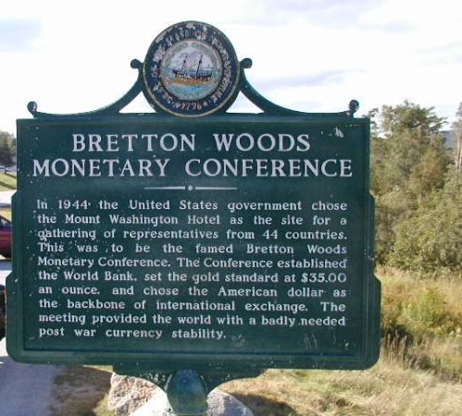
July 1–22, 1944
Notes:
As world peace resumed in 1945. the world leaders gathered in the US town of Bretton Woods to try to find an agreement about global currencies, which they thought would provide for stability.
The Bretton Woods Agreement which established the fixed exchange rate, gold convertibility monetary system emerged.
What did that mean?

Slide 4











DM
US
Fr
L.
$US 35
Notes:
The system pegged national currencies to the US dollar at agreed parities, which in turn was pegged at a FIXED parity with Gold ($US35 per ounce).
The relevance here is that central banks had to carefully manage the amount of their currencies in the system to ensure they maintained the agreed parities with other currencies.
An excess supply of say, Australian dollars (pounds before 1966) in foreign exchange markets required the Reserve Bank of Australia (RBA) to purchase dollars with foreign currency reserves and increase domestic interest rates to attract foreign investment (and demand for dollars).
But the money supply contraction and higher interest rates pushed unemployment up and if expansionary fiscal policy was used too aggressively to reduce unemployment – putting currency back in the system – it would compromise the RBA’s efforts to maintain currency stability.
As a consequence, without an increase in gold reserves, increased government expenditure (injecting currency) had to be matched (‘financed’) by taxation and if they wanted to spend more than their tax revenue, they had to issue debt (draining currency).
The system essentially ended on August 13, 1971 when President Nixon abandoned the convertibility.

Slide 5
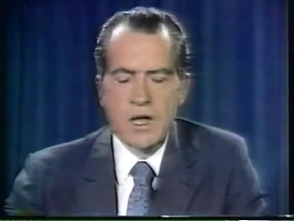
Notes:
August 16, 1971 - the era of MODERN Fiat currencies begins.
The MONETARY SYSTEM for most nations changed at that time.
What did that mean?

Slide 6
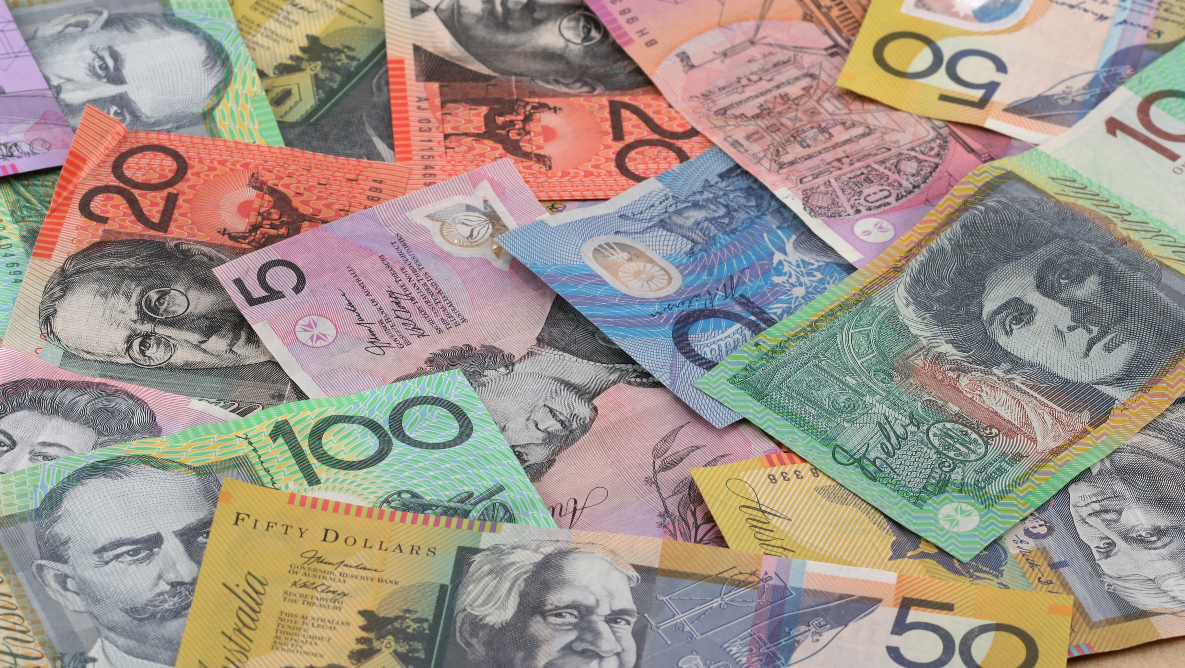
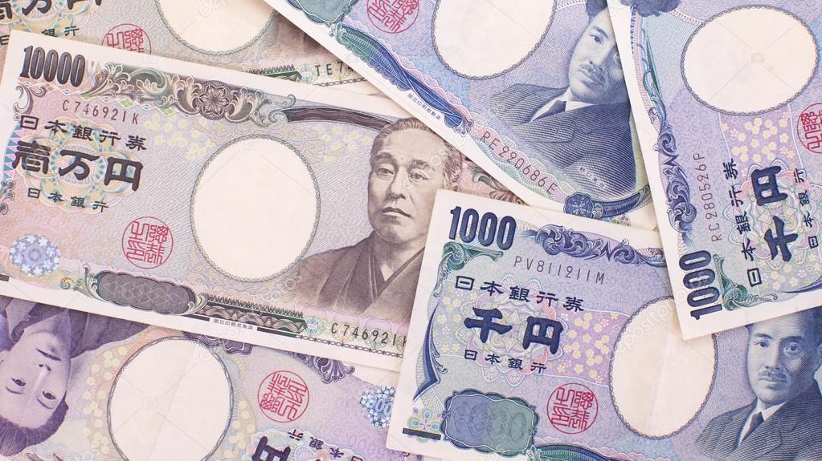
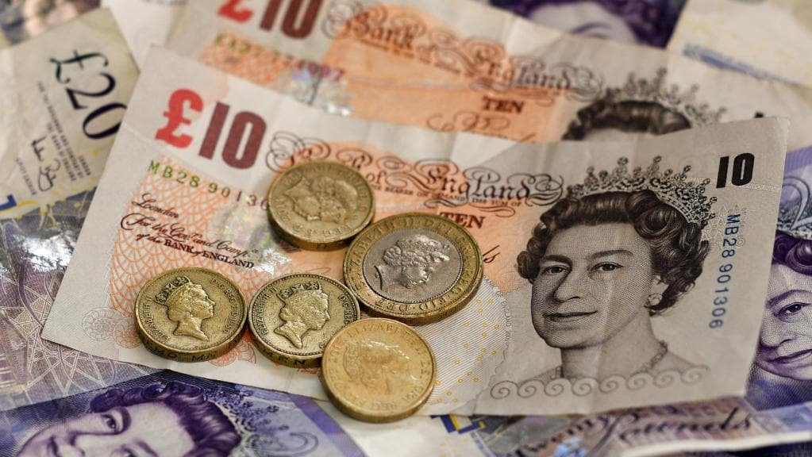

Notes:
The Australian Dollar is a fiat currency, for which the Australian government is the sole issuer.
It floats on international markets and is not pegged to any other currency or commodity (like gold).
And is the only unit that can be used by the non-government sector to relinquish tax liabilities to the Australian government.

Slide 7

Notes:
Eurozone an exception among others.
It is not a sovereign currency. The euro nations effectively use a FOREIGN currency.
We will consider what that means in Lecture 6.

Slide 8
Notes:
What does it mean for a nation to have its own currency?
The collapse of the Bretton Woods system dramatically altered the opportunities available to currency-issuing governments.
Here we start the MMT journey …
First, under a fiat monetary system, ‘state money’ no longer had any intrinsic value (no longer convertible into gold). For an otherwise ‘worthless’ currency to be acceptable in exchange (buying and selling things) some motivation was required. That motivation emerges because the sovereign government requires its use to relinquish private tax obligations.
Second, as the monopoly issuer of the fiat currency, the Bretton Woods restrictions to offset spending with taxation and/or borrowing are no longer binding because the central bank no longer has to defend the floating currency. There is no financial constraint on government spending. The government can buy any goods and services that are available for sale in its currency including all unemployed labour.
The only meaningful constraint is the ‘inflationary ceiling’ that is reached when all productive resources are full employed. This is a dramatic change.
The Australian government cannot run ‘out of money’ and all notions of not having enough ‘ammunition in the locker’ because the government has been running deficits (spending in excess of tax revenue) are inapplicable.
Accordingly, we traverse from thinking about financial constraints on government spending and all the negative narratives about the need to ‘fund’ spending, to a focus on real resource constraints defined in terms of available productive resources and available final goods and services. Another dramatic shift in thinking.
Third, logically, the government no longer needs to issue debt, given it is the issuer of its own currency. Debt issuance serves other purposes which evade public scrutiny.
Crucially, politics is freed from the perennial: ‘How are we going to pay for it’ question.
The questions we now ask are different and relate to functional outcomes we desire from public spending and available real resources.
Typically, one nation, one currency.
Eurozone an exception (Lecture 6).
The sovereign government, alone, has the power to determine which money of account it will recognise for official accounts.
Why does the private sector accept an otherwise worthless currency issued by the government when it makes purchases?

Slide 9

Notes:
If you scan the Internet, you will often see statements like: Won't it be shocking if we ever have MMT or the opposite depending on the position you take on policy matters.
The other way that this confusion is expressed is to say that MMT policies will be bad or MMT policies will be good, again depending on your ideological preferences.
Neither characterisation of MMT is correct.
At the outset, we must be clear that MMT is not a regime that we can go to or move away from.
There is also no sense in saying that MMT policies more or less desirable, more or less beneficial, or more or less disastrous.
MMT is, rather, what we might think of as a lens (CLICK), and, in the same way that wearing glasses helps us to see better when our eyes are defective, MMT enhances our understanding of the way the monetary system operates, the capacities of currency-issuing governments, and the consequences of using that capacity in different ways.
It also helps us to understand the consequences of a nation surrendering their currency issuing capacity, for example, as the 19 Member States of the economic and monetary union in Europe have done.
By providing a superior understanding of the way the monetary system operates, an MMT understanding exposes the myths that mainstream macroeconomics promotes to suppress the capacities and options available to currency-issuing governments.
In this sense, it exposes many commonplace economic statements and assertions as meagre artifacts of ideology.
We say that citizens are then better placed to participate more meaningfully in the political process and discriminate more clearly and expertly between the policy options being offered by the politicians.

Slide 10
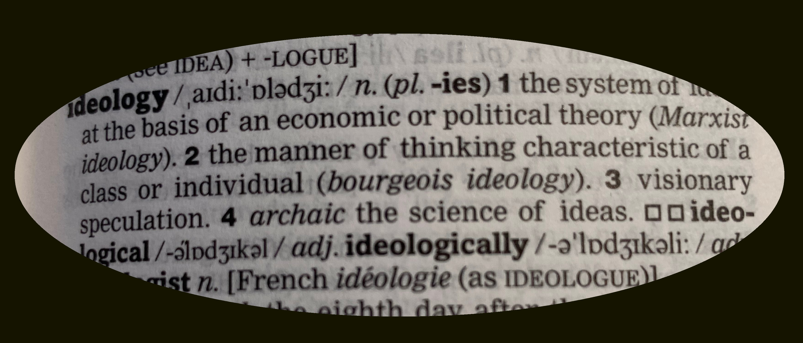
What about policy?
Notes:
What about policy? (CLICK)
MMT is mostly agnostic about policy.
To exploit an MMT understanding to inform policy development requires that we overlay a set of values (ideology) (CLICK), which then defines the options we might consider appropriate for the government to pursue, given its capacities.

Slide 11

Collectivism
ECONOMIC SCALE
Left
Right
SOCIAL SCALE
Individualism
Notes:
In terms of the traditional Right-Left ideological space supplemented with views about collectivism (state biased) or individualism (libertarian biased) (CLICK)
An MMT understanding enhances positions in any of the quadrants (CLICK)
A person with values leaning towards Left-collectivist positions (CLICK), will use their MMT understanding to want more state involvement in the economy and will advocate policies, for example, that sustain full employment, promote high quality public infrastructure and achieve distributional equity.
Conversely, a person with the opposite value set or ideology (CLICK), will use their MMT understanding to support more private enterprise promotion with smaller fiscal deficits and more deregulation.
The point is that the ideological motivation becomes more transparent, and conservative politicians, for example, would then be unable to simply dismiss carbon reduction policies by saying the government did not have enough money!
Everyone would know that was not a truthful statement.
In this way, an MMT understanding improves the quality of our democracies.

Slide 12

MM
T
Notes:
So what is the T in MMT about? (CLICK)
MMT is quite different from mainstream macroeconomic approaches because it combines a deep understanding of the actual institutional structure of the economy, which embraces the actual operational characteristics of government and monetary institutions (like banks and central banks), with historical knowledge, and, behavioural or theoretical conjectures that link macroeconomic aggregates together.
The T in MMT relates to these theoretical aspects.
Many casual observers fall into the trap of thinking that MMT is just a descriptive framework - documenting the way the monetary system functions and providing accounting structures, which captures all the monetary flows correctly.
However, underlying the accounting and descriptive elements, must be theoretical conjectures about how the various aggregates are linked.
Let's go back to the summer of 1666 and we are sitting in the garden at Woolsthorpe Manor, in Lincolnshire musing away the time. (CLICK)
Suddenly an apple falls from the tree we are sitting under.
We could DESCRIBE what happened and MEASURE it - the time it took to hit the ground.
But that alone will not allow us to understand why it fell in the first place.
That requires an understanding of Newton's law of universal gravitation (and later Einstein's general theory of relativity)
The theory adds meaning to our description and allows us to make better predictions of cause and effect.
In the real world we can measure increases in government spending, and increases in GDP, household incomes and more.
But to understand WHY households are able to consume more and become wealthier when governments increase their fiscal deficits, we need to have theoretical notions about human behaviour which allow us to develop the causal chains.
That is why it is MMTheory.

Slide 13
Money Story
Banking Story
Capital Markets Story
Resource Story
Trade Story
Inflation Story
Stability Framework Story

Slide 14
The Money Story

Slide 15












The provisioning challenge
Government
Non-Government

Slide 16

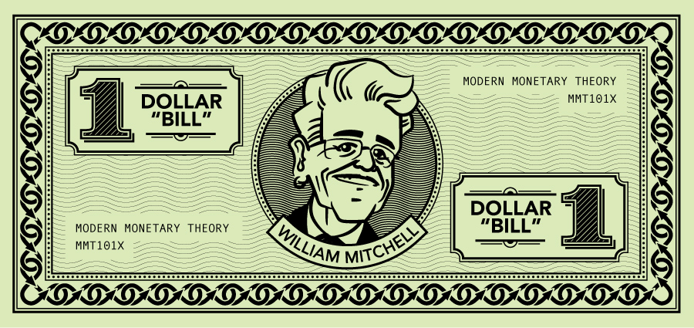
Notes:
Why would anyone want to hold this worthless currency?

Slide 17
B
100
Notes:
What problem does this present for citizens in the non-government sector?

Slide 18


spends
Government
Non-government
B
100

Slide 19
Tax liability
Spending
Tax Payments
Notes:
The MMT causality.
Government spends its currency into existence.
The non-government sector will exchange real goods and services for this currency because it has to relinquish its tax obligations using it.
Taxes do not fund the government spending but create real resource space to allow it to spend without causing inflation.

Slide 20
Government
Year 1
Non-government
Spending | 100 |  | Income
Wages | 100 |  | Wages
Interest payments | 0 |  | Interest received
Taxes |  |  | Taxes paid
Fiscal injection |  |  | Overall saving
Bonds outstanding | 0 |  | Financial Wealth | 0
 |  |  | Cash | 0
 |  |  | Bonds held | 0

Slide 21
Government
Year 1
Non-government
Spending | 100 |  | Income | 100
Wages | 100 |  | Wages | 100
Interest payments | 0 |  | Interest received | 0
Taxes |  |  | Taxes paid
Fiscal injection |  |  | Overall saving
Bonds outstanding | 0 |  | Financial Wealth | 0
 |  |  | Cash | 0
 |  |  | Bonds held | 0

Slide 22
Government
Year 1
Non-government
Spending | 100 |  | Income | 100
Wages | 100 |  | Wages | 100
Interest payments | 0 |  | Interest received | 0
Taxes | 100 |  | Taxes paid | 100
Fiscal injection |  |  | Overall saving
Bonds outstanding | 0 |  | Financial Wealth | 0
 |  |  | Cash | 0
 |  |  | Bonds held | 0

Slide 23
Government
Year 1
Non-government
Spending | 100 |  | Income | 100
Wages | 100 |  | Wages | 100
Interest payments | 0 |  | Interest received | 0
Taxes | 100 |  | Taxes paid | 100
Fiscal injection | 0 |  | Overall saving | 0
Bonds outstanding | 0 |  | Financial Wealth | 0
 |  |  | Cash | 0
 |  |  | Bonds held | 0

Slide 24
Government
Year 2
Non-government
Spending | 120 |  | Income | 120
Wages | 120 |  | Wages | 120
Interest payments | 0 |  | Interest received | 0
Taxes | 100 |  | Taxes paid | 100
Fiscal injection |  |  | Overall saving
Bonds outstanding | 0 |  | Financial Wealth | 0
 |  |  | Cash | 0
 |  |  | Bonds held | 0

Slide 25
Government
Year 2
Non-government
Spending | 120 |  | Income | 120
Wages | 120 |  | Wages | 120
Interest payments | 0 |  | Interest received | 0
Taxes | 100 |  | Taxes paid | 100
Fiscal injection | +20 |  | Overall saving | +20
Bonds outstanding | 0 |  | Financial Wealth | 20
 |  |  | Cash | 20
 |  |  | Bonds held | 0

Slide 26
Government
Year 3
Non-government
Spending | 120 |  | Income | 120
Wages | 120 |  | Wages | 120
Interest payments | 0 |  | Interest received | 0
Taxes | 100 |  | Taxes paid | 100
Fiscal injection | +20 |  | Overall saving | +20
Bonds outstanding | 40 |  | Financial Wealth | 40
 |  |  | Cash | 0
 |  |  | Bonds held | 40
Bond sale

Slide 27

Austerity mindset adopted …

Slide 28
Government
Year 4
Non-government
Spending | 80 |  | Income | 80
Wages | 76 |  | Wages | 76
Interest payments | 4 |  | Interest received | 4
Taxes | 100 |  | Taxes paid | 100
Fiscal injection | -20 |  | Overall saving | -20
Bonds outstanding | 20 |  | Financial Wealth | 20
 |  |  | Cash | 0
 |  |  | Bonds held | 20
Notes:
What did we learn?
Government deficit spending adds exactly that amount to non-government income.
Fiscal deficits are the only way the non-government sector can simultaneously accommodate a net desire to save overall and eliminate unemployment.
Government surplus creates an equal drop in Non-Government wealth.
The concept of the Government saving in its own currency is not applicable!

Slide 29
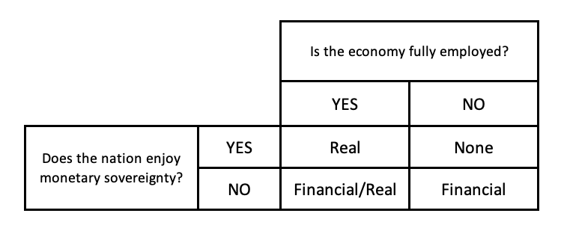
Evaluating the constraints on government spending
MMT
Yes
Yes
Real

Slide 30
Evaluating the constraints on government spending
MMT
No
Yes
None

Slide 31
Evaluating the constraints on government spending
MMT
Yes
No
Financial/Real

Slide 32
Evaluating the constraints on government spending
MMT
No
No
Financial

Slide 33
Evaluating the constraints on government spending
Mainstream Macro
Yes
Not a relevant distinction
Financial/Real

Slide 34
Evaluating the constraints on government spending
MMT
No
Not a relevant distinction
Financial

Slide 35
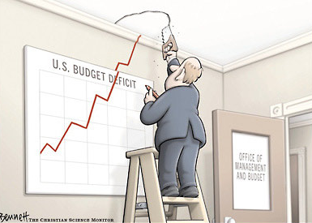
Notes:
There is no ‘good’ or ‘bad’ deficit – context is crucial.
Deficits generate income and saving in non-government sector.

Slide 36
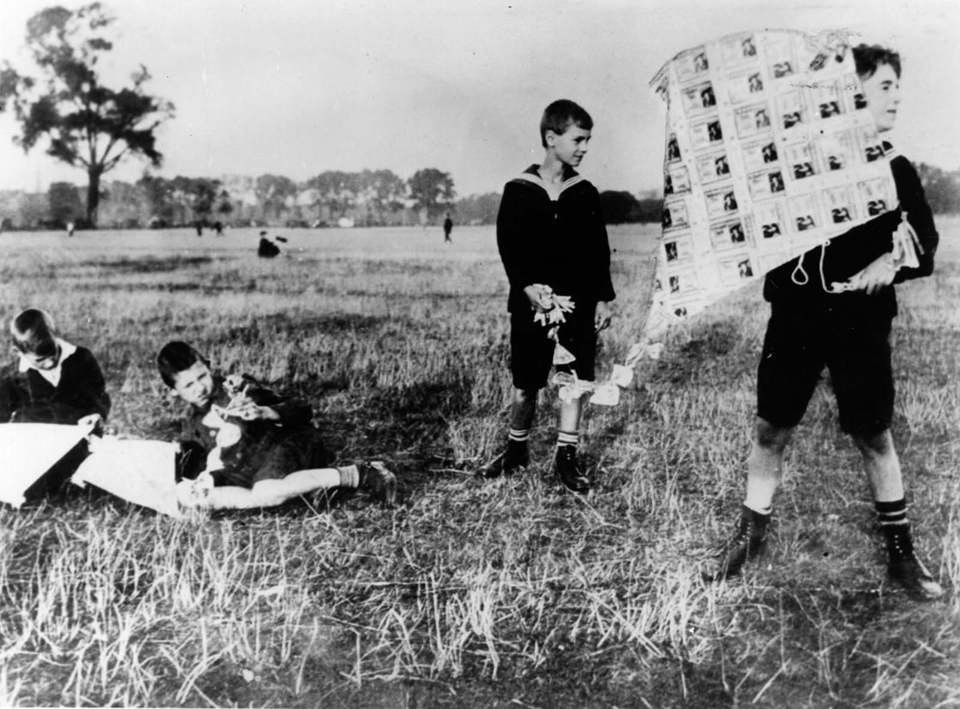
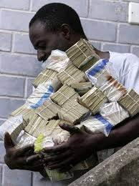
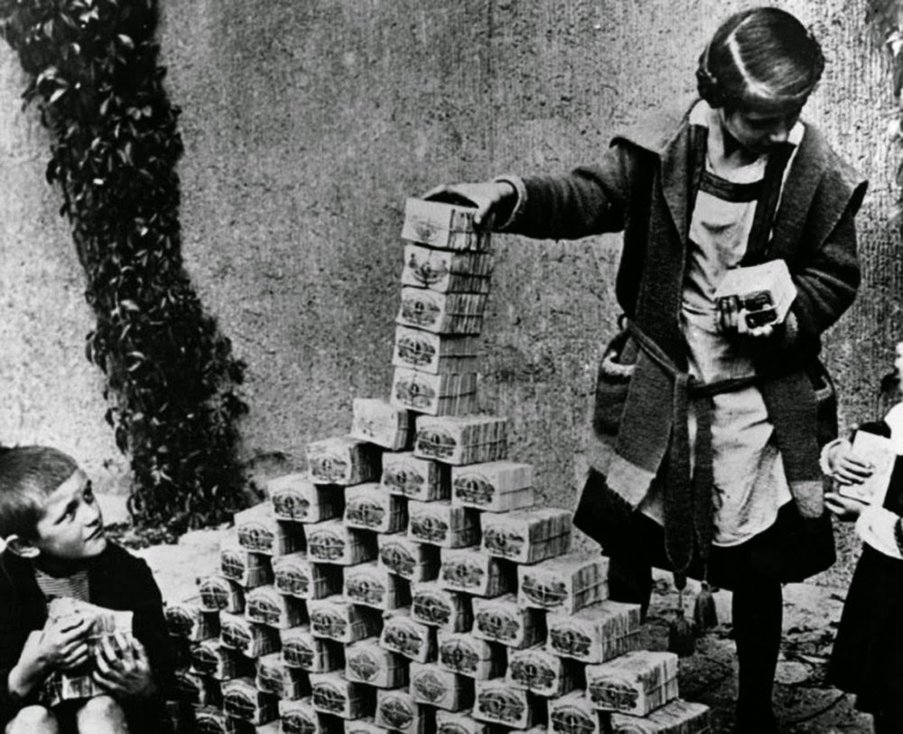
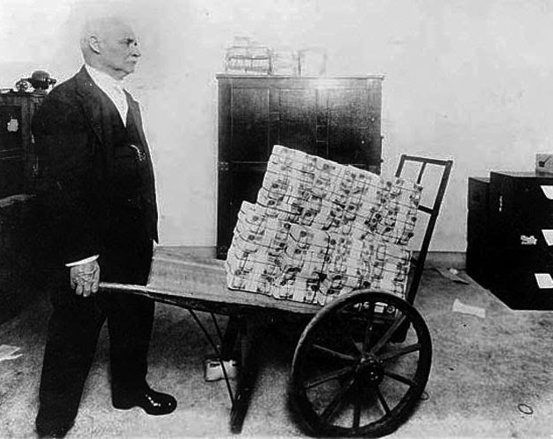
Notes:
All spending carries an inflation risk.
The constraints on government spending are not financial.
Currency-issuing governments can purchase whatever is for sale in its own currency, including all idle labour.
Government spending is thus constrained by the availability of real resources.
Inflation arises when spending exceeds the productive capacity of the economy to respond in real terms.
Spending offsets to accommodate public spending.
Mainstream argument is that fiscal deficits pump too much money into the economy and eventually there is hyperinflation.
The usual examples Zimbabwe etc tell us nothing about that.
The price pressures were largely due to supply-side contraction – Treaty of Versailles and reparations in Weimar; Farm reform in Zimbabwe.
Fiscal deficits do not cause inflation unless they push spending growth to quickly.

Slide 37

Government
Non-government
TOTAL SAVING
Notes:
Crowding out and interest rates

Slide 38
Government
Non-government
TOTAL SAVING
Notes:
But increasing fiscal deficits stimulate national income (GDP) and increases total saving in the economy.
Spending brings forth its own saving.

Slide 39
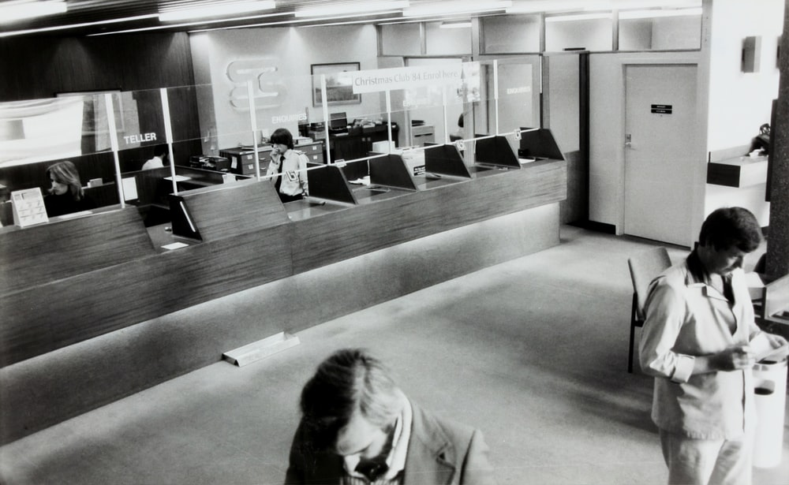
Notes:
Moreover, modern banking systems do not resemble loanable funds model.
What does a private bank do?
Loans create deposits – any credit-worthy borrower can get funds.
Fiscal deficits actually put downward pressure on interest rates – excess banking reserves.
Who sets the interest rate?
The central bank.
What if there is a fiscal deficit?
Excess reserves!
Direction of interest rates – down!
Penalty for not borrowing? – see Japan!
Do governments need to borrow anyway?

Slide 40

K. Mitch Hodge
@kmitchhodge
Notes:
The ageing society problem.
Mainstream depiction.
The real problem is a productivity one.
Rising dependency ratios mean future generations will need to be more productive than the past to ensure there are sufficient real goods and services available.
We also need to ensure the availability of real resources to meet the desires of the population.

Slide 41

Boston Public Library
@bostonpubliclibrary
Notes:
Mortgaging our kids future?

Slide 42


Dan Meyers
Unsplash
Jackie Hope
@jackieboylhart
Notes:
How to pay for it?

Slide 43


Edwin Hooper
@edwinhooper
Brian McGowan
@sushioutlaw
Notes:
Austerity is myopic thinking.
Investment in public health systems have long lasting socio-economic returns.
A false dichotomy was created at the outset - health versus economy.
Government responses driven by worries about necessary spending increases.
Europe is still in chaos without a stimulus package.
Health first, supported by government, then economy.

Slide 44
END OF TALK

