Slide 1


Eurozone Dystopia: Groupthink and Denial on a Grand Scale
Professor William Mitchell
University of Newcastle, Australia
University of Helsinki, Finland

Slide 2

Published 2015

Slide 3
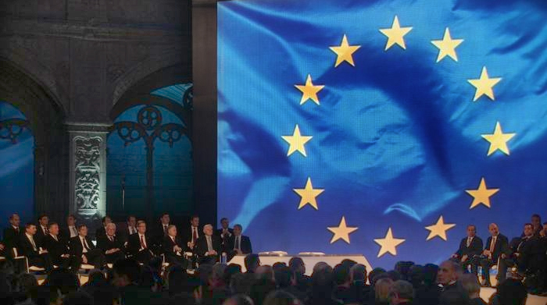

… enhancing the efficiency and democratic legitimacy of the Union
Notes:
Signed at the Jerónimos Monastery of Lisbon, Portugal, the Treaty of Lisbon amended the Maastricht Treaty (1992), known in updated form as the Treaty on European Union (2007) and the Treaty of Rome (1957), known in updated form as the Treaty on the Functioning of the European Union (2007),
The process consolidated the Economic and Monetary Union, which represents an advanced expression of the corporatism and neoliberalism.
Unlike other nations which might have embraced the neoliberal ideology, the EMU has embedded in the ideology into the EU Treaties. The ideology has become LAW.
The flawed design of the Economic and Monetary Union (EMU) makes it dysfunctional.
We will see why I think the best option is an orderly dissolution.
The next best option for a single state is unilateral exit.
Other options which retain the euro are identifiable but impossible to implement.

Slide 4
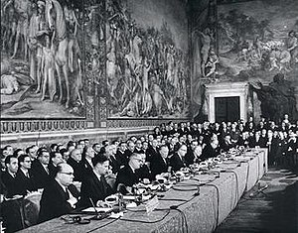
Importance of history…
Roma, March 25, 1957
Notes:
If we understand the long history that led to the creation of the monetary union, we also know about the difficulties that arise when nations with very different economic structures and which demonstrate lack of cultural solidarity face when they try to fix exchange rates and adopt a common currency.

Slide 5
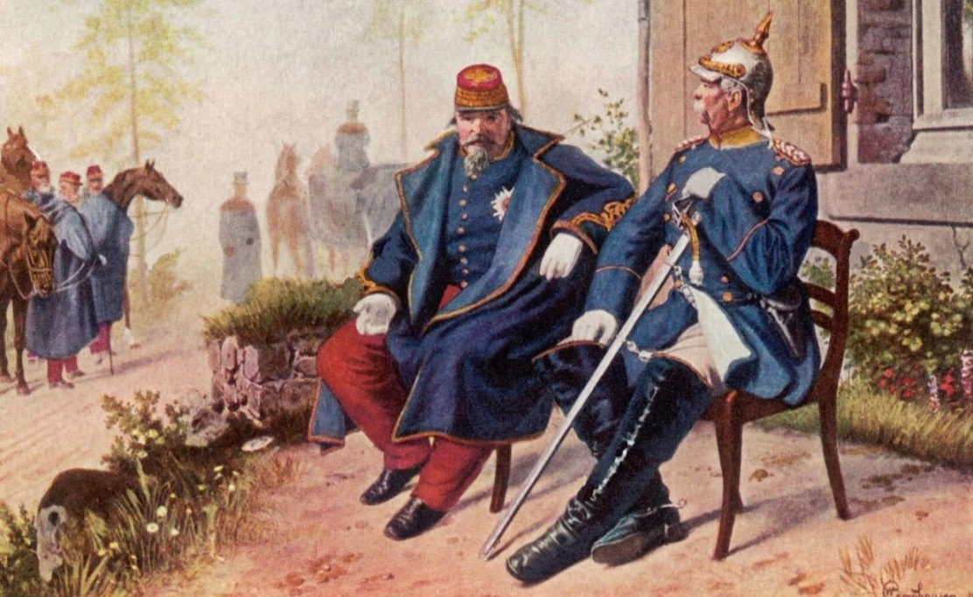
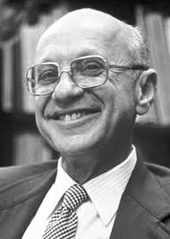
Notes:
Europe has been driven by Franco-German rivalry.
In the modern era the Franco-Prussian war 1871 seeded intense rivalry over Alsace-Lorraine
And history also allows us to understand that the more recent stages in European integration were achieved by an intersection in the 1980s between the growing dominance of neo-liberal economics, specifically, MONETARISM and this long-standing Franco-German rivalry.
The result was the Eurozone and a destructive Groupthink that undermines prosperity, denies reality, and rejects viable solutions to the crisis on ideological grounds.

Slide 6
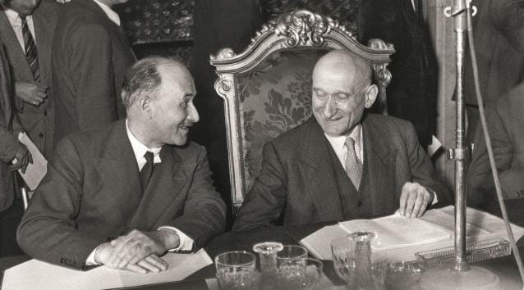
Notes:
The great European visionaries in the immediate post World War II period – Jean Monnet (LEFT) and Robert Schuman (RIGHT) - did not desire to put the European economies into a straitjacket of austerity and hardship.
Their aim was peacetime prosperity – the ‘European Project’.
To render the Franco-German rivalry benign.
The background was the Post WWII Keynesian consensus - the anathema of what the EMU has become.

Slide 7
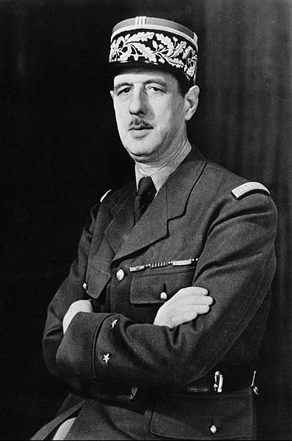

Notes:
The process of integration doomed from the start?
Motivations were wrong from the outset.
1. Franco-German rivalry – 1957 Treaty of Rome (CLICK).
2. French vision of European domination (De Gaulle). (CLICK) - Domination of Planning Ministry over Finance Ministry.
3, CAP (1962) forced an obsession with fixed exchange rates with the Bretton Woods system.
But fixed exchange rate system was under pressure from start – the Triffin Paradox.

Slide 8
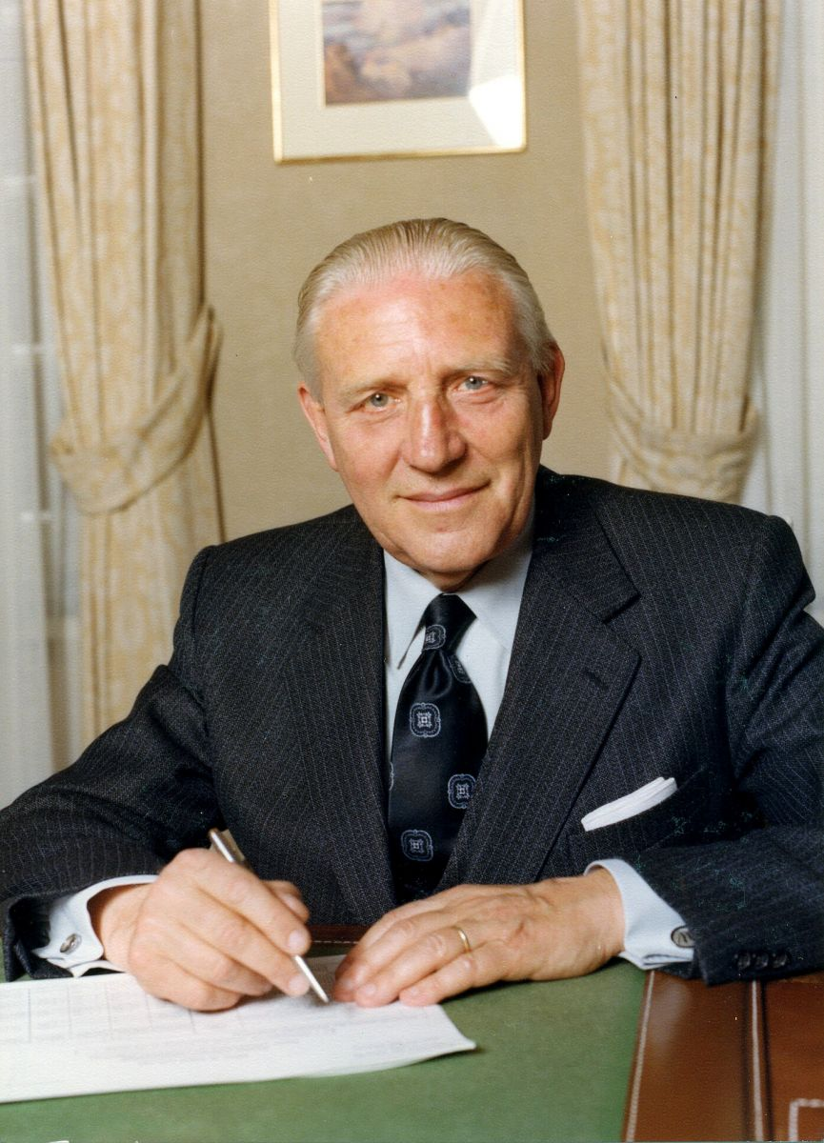
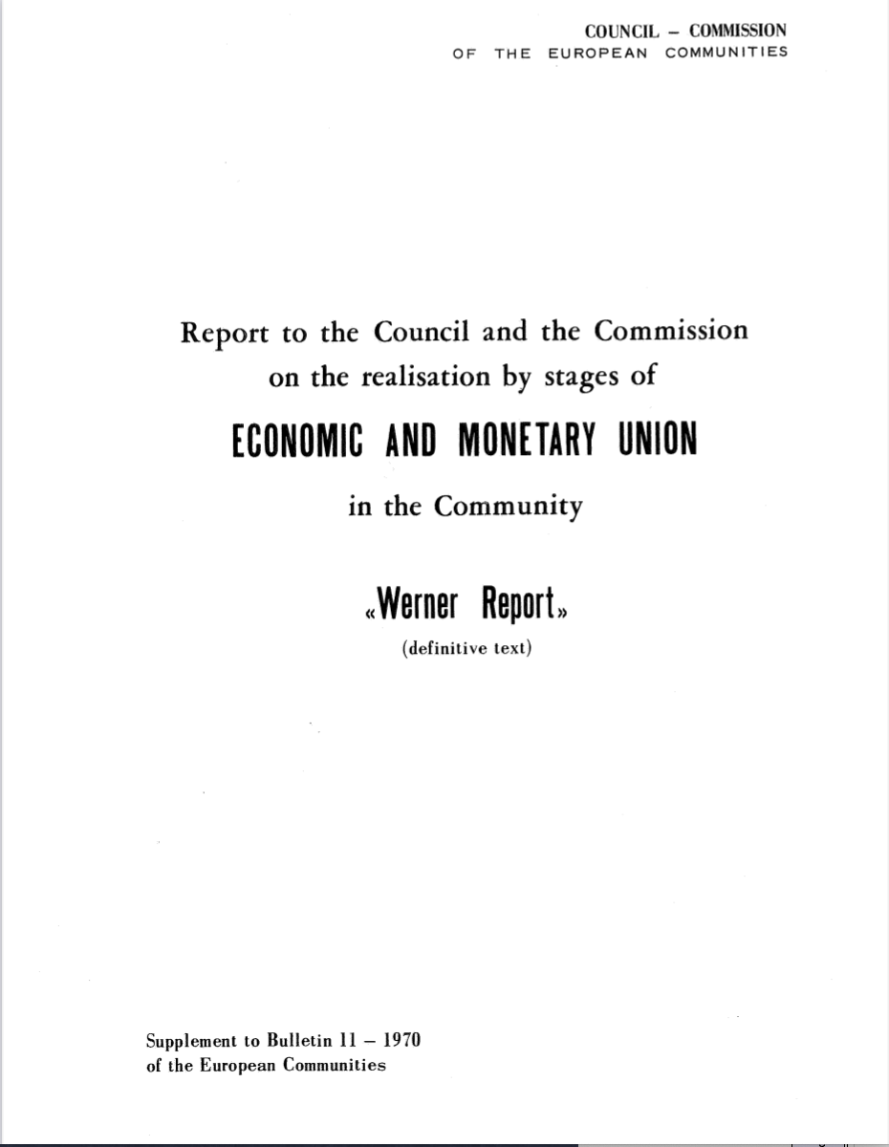
Notes:
Werner Report 1970 was the product of agreements reached at the Hague Summit 1969 to explore the conditions for monetary integration.
Emphatic conclusions about requirements of a monetary union.
No progress – French fear of German domination.

Slide 9

I will begin to believe in European economic and monetary union when someone explains how you control nine horses that are all running at different speeds within the same harness
Frede Sunesen
Danish central bank governor, 1972
Notes:
Danish central bank governor - 1972

Slide 10
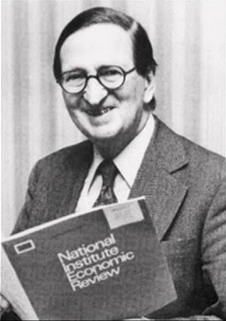
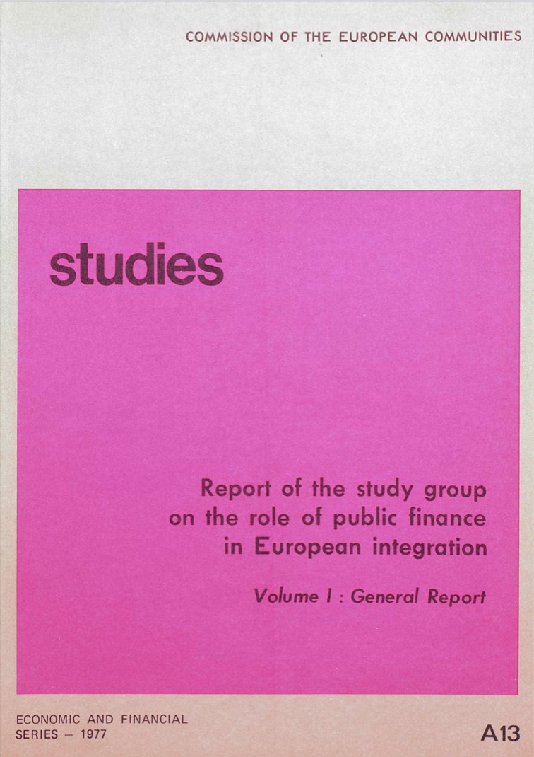
Notes:
At the end of 1974, the European Commission asked a group of independent economists with Sir Donald MacDougall as Chairman) to examine the future of public finance at the Community level in the general context of European economic integration.
Sir Donald MacDougall, had been Economic adviser for Churchill in the Second World War to Edward Heath in the 1970s.
The committee met between 1975 and 1997 and produced a final report in 1977 – the so-called MacDougall Report 1977.
Both Werner and MacDougall emphasised that an effective economic and monetary union would require a strong fiscal presence at the federal level with democratic legitimacy.
They both studied functional federations.
Both committees were comprised of Keynesian economists.
MacDougall concluded that: “EEC not close to conditions for financial integration ... Unlikely to achieve conditions ...”
The

Slide 11
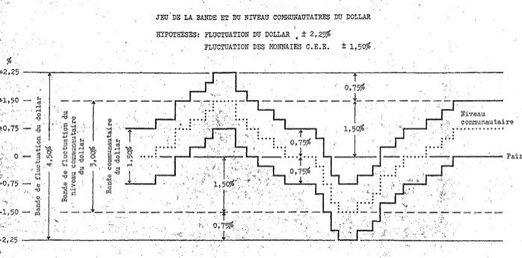
The Tunnel 4.5% against USD
Notes:
1971 – Bretton Woods breaks down.
Europe tried to salvage the fixed exchange rate system internally.
Why?
Because of the CAP - Europe pressed on.
1972 –The Basel Accord produced Le serpent et le tunnel – Théron group of experts, February 1972
The Théron group of experts recommended that the ‘snake’ (the allowable fluctuations of the European currencies) should be plus or minus 1.5 per cent in a ‘tunnel’ of 4.5 per cent
From July 1, 1972, the fluctuations between currencies of the Member States would not exceed 2.25 per cent, which was a rather skinnier snake than the 3 per cent recommended by the Théron group of experts but still consistent with the hope of returning to largely fixed exchange rates.
1973 - Snake escaped quickly and tunnel abandoned in 1973.

Slide 12
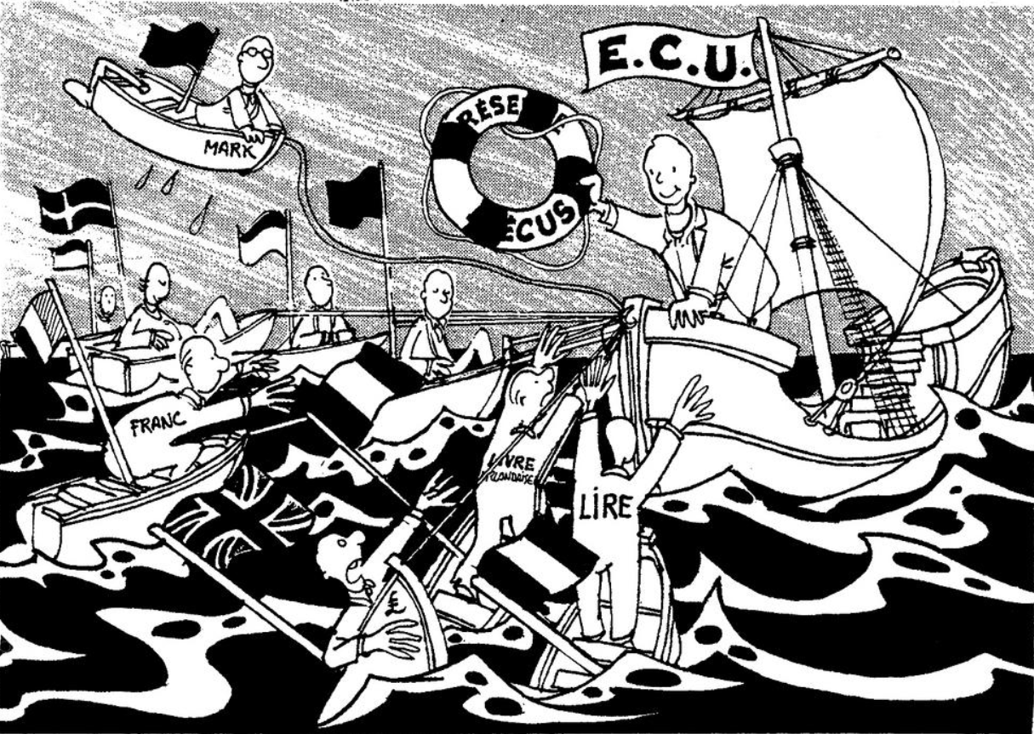
Notes:
But before that there was currency chaos - Britain out (June 1972) - France went in and out of the arrangement – politically unviable.
European Monetary System (EMS) emerges out of the mess in 1978 - the myth of symmetrical intervention – effectively a DM zone!
Role of capital controls – another lesson ignored!
Black Wednesday – September 16, 1992.
Lessons were clear but ignored by decision makers a bit later (Delors)
Nations with very different economies and export strengths – like Italy, France and Germany - cannot jointly prosper by tying their exchange rates together.
The German export strength and the uncooperative Deutsche Bundesbank made sure of that in the 1980s leading up to the euro.

Slide 13
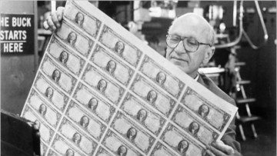
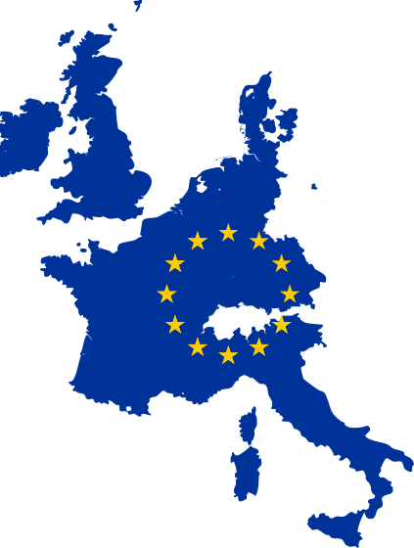
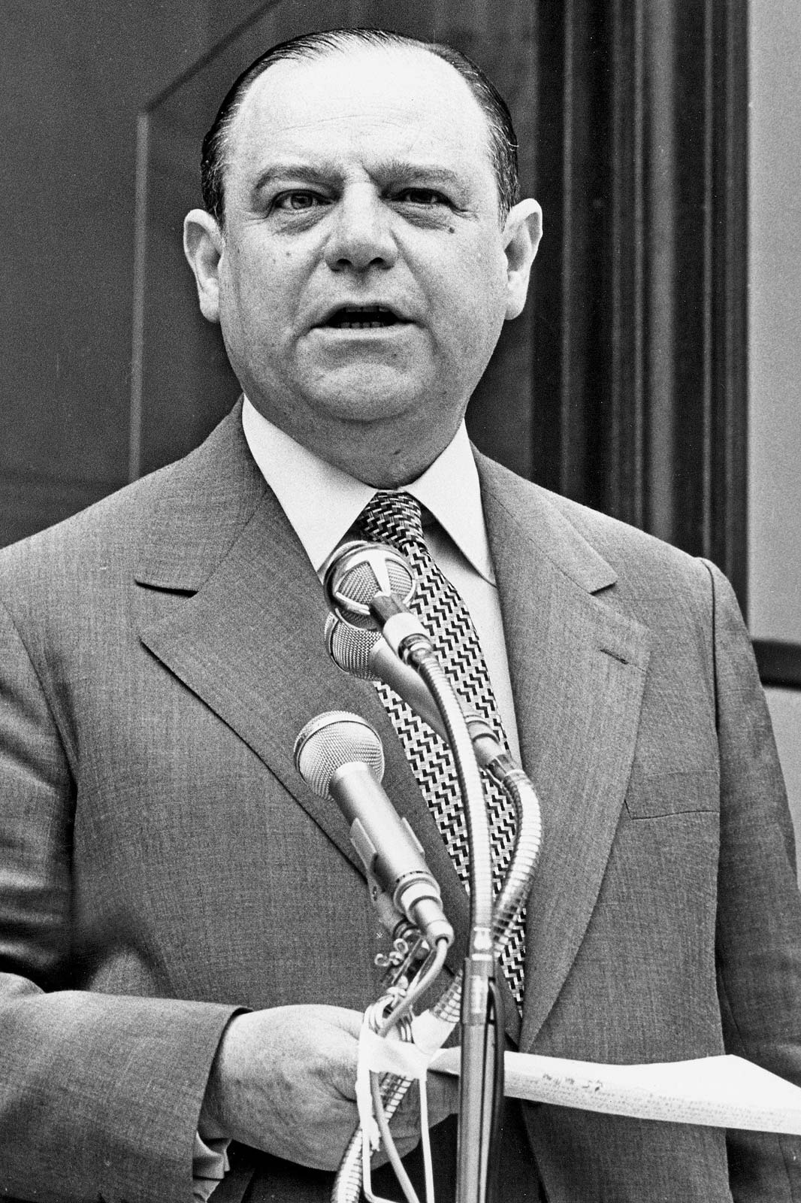
Notes:
The ‘nine horses’ eventually harnessed together - not through diminished Franco-German rivalry but, because of a broad acceptance of Monetarism through the 1970s.
Trapped in belief that self-regulating “free” markets would deliver the best outcomes for all.
Fear of inflation elevated it to top policy priority.
Barre Plan 1976 – triumph of French Finance Ministry. Raymond Barre was Prime Minister under President Valery Giscard d’Estaing
France succumbs and becomes ‘German’ – the ‘franc fort’ ambitions of Delors.

Slide 14
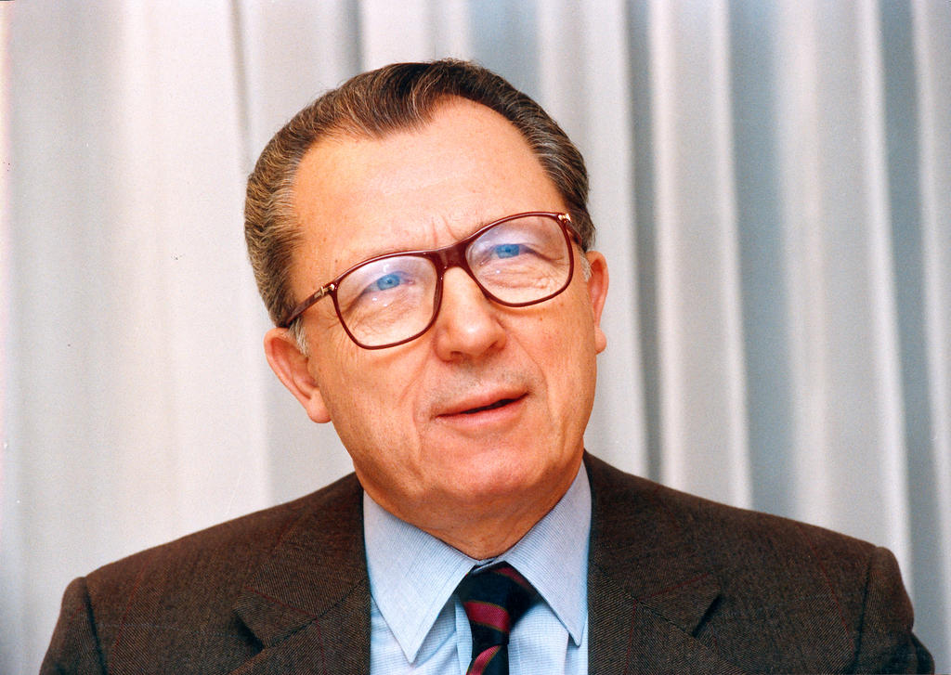
Notes:
Delors Report 1989…
Driven by Monetarist ideology.
Abandons insights from earlier reports (Werner etc).
Maastricht Treaty – surrender of currency sovereignty.
Failure to create a ‘Federal’ fiscal capacity - major flaw.
Arbitrary SGP – ‘back of envelope’ - – neither stability nor growth.
Convergence farce - OCA conditions never met.
Fixed exchange rate – so domestic economy has to make the adjustment to trade imbalances.

Slide 15
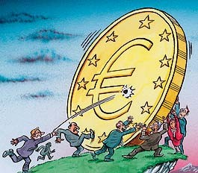
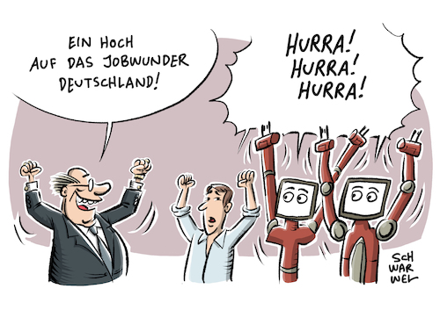
Notes:
The Jobwunder – Germany’s Job’s Miracle under the Hartz reforms initiated by Gerhard Schröder in 2003.
Period of ‘stability’ – German hypocrisy and austerity! Germany lost control of its exchange rate and embarked on internal devaluation via the Hartz process – Mini jobs.
It really ‘gamed’ the other Member States and set up the conditions for the later trade imbalances etc.
The 2003 crisis – France and Germany saw the early failure of the SGP.
“3 doesn’t mean 3.0” – Theodore Wegel.
Low interest rates – ‘one size fits all’.
Trade and credit imbalances

Slide 16
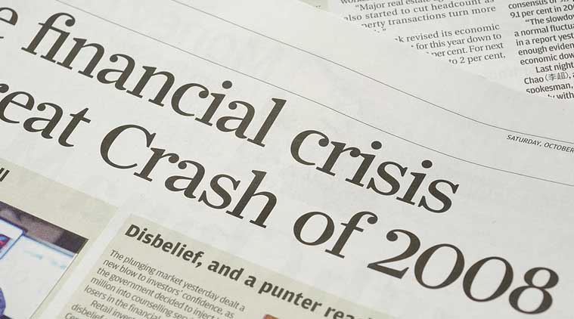
The GFC was inevitable …
Notes:
The private credit binge was always going to crash.
Housing boom in Southern Europe fuelled by German capital derived from export surpluses and low ‘once-size-fits-all’ interest rates.
Interest rates were low because Germany dominated and had been in recession.
A balance-sheet crisis resulted.
Correct response was to sustain fiscal deficits.
Period of crisis
flawed EMU design exposed
Automatic stabilisers blew SGP limits.

Slide 17
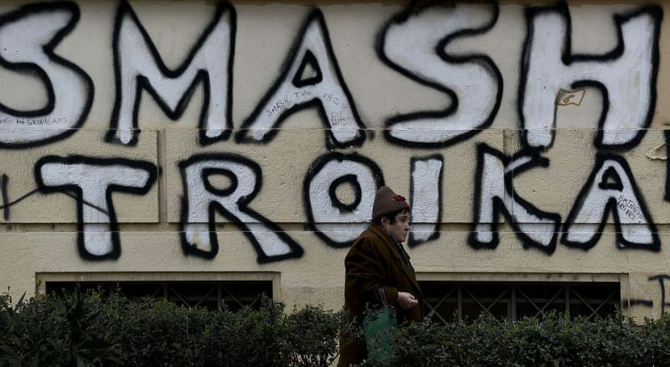
Notes:
The Troika policy response
Democratic deficit widens.
Pro-cyclical fiscal policy – anathema of sound macroeconomic management.
Based on the IMF myth of a “fiscal contraction expansion”.
Failed to understand that:
(a) Households will not consume if threatened with loss of pay and rising unemployment.
(b) Firms will not invest when consumers are not spending.
Malpractice ...
Destruction of Greece.

Slide 18
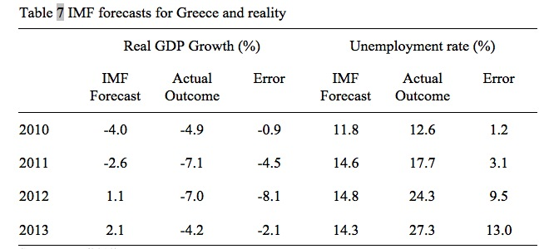
Groupthink in action …
Notes:
2012 apology for getting the multiplier estimates wrong.

Slide 19
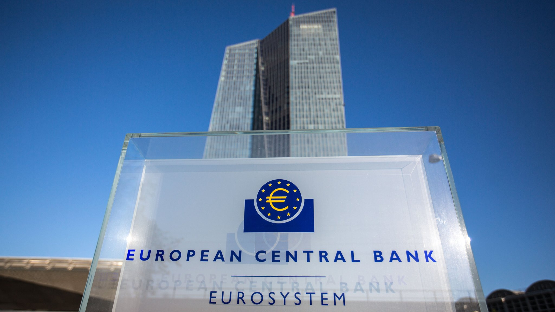
Notes:
So-called independent central bank has clearly played a key political role.
Implicit fiscal function – the only way the EMU nations are still solvent.
Violated spirit of the Treaty …
May 2010 - Securities Market Program (SMB) – bypassed rule of “no bailouts”.
It became a charade of mammoth proportions – their liquidity justifications for the bond buying.
Admission of failure in design.
Its role in Troika and Greek situation – threatening bank failure violated its essential role to maintain financial stability.
That continues today - with the on-going APP and the new PEPP.

Slide 20



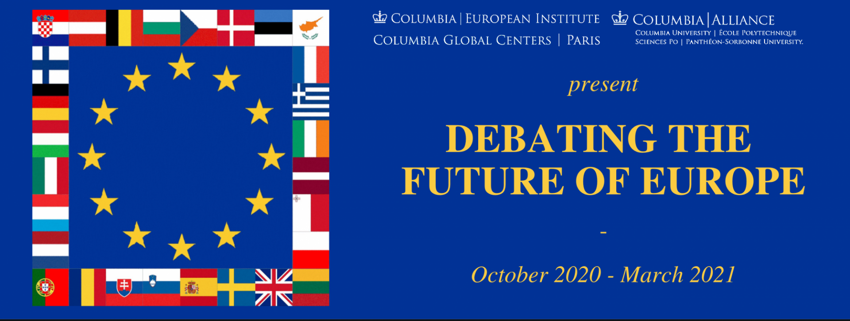
Notes:
Europe talks about itself a lot. But does less.
What is the future of Europe?
Britain has now left.
Do Pan National arrangements have a role? – big issues migration, health, human rights.
The SGP is currently in suspension under the temporary clauses of the Annexe.
The ECB is essentially funding the whole system.
Since GFC:
1. MIGRATION scandal
2, The chronically slow decision making has failed to deliver a stimulus.
3. The vaccination process is slow and the virus is rampant.
4. Divergence is the norm.
5. Anti-establishment revolts are growing – yellow vests etc.
OPTIONS
Tightening fiscal rules – Restore Excessive Deficit Mechanism - only make matters worse – bias towards stagnation and race to bottom.
Creation of true supra-national fiscal capacity – would work but will not happen. – there is no ‘Europe’
Orderly dissolution – preferred option Restoration of currency sovereignty.
Unilateral exit.
Latest ideas – ECB cancel all the debt.
Prosperity via currency sovereignty.
Better is the result multilateral dissolution agreement.
But unilateral exit still a superior option to euro.
The euro is the problem!

Slide 21
END OF TALK

