Slide 1
Buffer stocks – unemployment and inflation
Professor William Mitchell
University of Newcastle, Australia
University of Helsinki, Finland

Slide 2
Chapters 17-19

Slide 3
Which buffer stock?
Notes:
Goals of government - full employment and price stability.
Efficiency – micro and macro losses.
A currency-issuing government which aims to stabilise prices has two available buffer stock options.
- Unemployment buffer stocks (NAIRU approach).
- Employment buffer stocks (Job Guarantee approach).
What is the best buffer stock policy?
Employment versus income guarantees.
If you really want to get on top of this topic then the prior understanding assumed
Debate about employment generation.
Why does unemployment occur?
Conflict theories of inflation.
Monetarism and QTM.
Expectations and Phillips curve.
Natural rate theories.
You can find text-based slides available at the end of this presentation which summarise this literature.

Slide 4
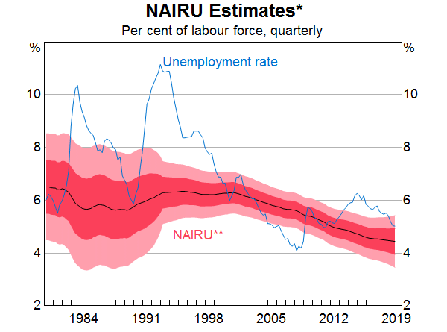
Notes:
Unemployment buffer stocks
Neo-liberal period characterised by the NAIRU approach.
Unemployment - a policy instrument rather than a policy target.
Disciplines spending and/or distributional struggle.
Extremely costly approach - huge net income losses.
Huge social costs.
Buffer stock deteriorates – lessens effective supply.
Encore?
Estimates are extremely imprecise – look at graph.

Slide 5
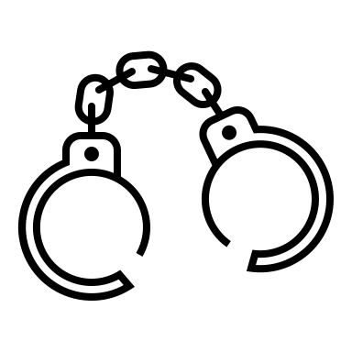
Rising sickness
Substance abuse
Skill Loss
+
Massive GDP losses
Mental illness
Rising crime
Deindustrialisation
Family breakdown
Rising poverty
Social instability
Notes:
Costs of unemployment
Labour underutilisation (unemployment + underemployment) creates huge net income losses.
The social costs are even larger:poverty, social isolation, crime.
-- health issues
family breakdown and school dropouts – INTERGENERATIONAL LOSSES
RISING Crim rates, promotes violence, ethnic hostility, even terrorism.
Increased substance and alcohol abuse.
Rising poverty rates.
Loss of human capital - hysteresis: long term unemployed become unemployable.
regional deterioration – Deindustrialisation.
social, political and economic instability.

Slide 6
Upskilling
Self-esteem
Income stability
Personal Risk Management
Falling poverty
Intergenerational stability
Stronger communities
Notes:
BENEFITS OF FULL EMPLOYMENT
Income stability.
Personal risk management.
Psychological well-being (social inclusion, self esteem etc).
Training and skill development in a paid-work context.
Poverty alleviation.
Community building.
Less crime and personal abuse
Intergenerational stability.

Slide 7
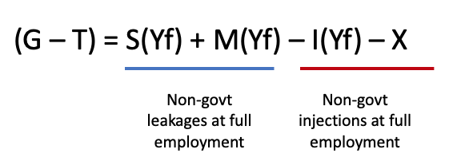
Total Spending
GDP
Employment
Notes:
WHAT CAUSES UNEMPLOYMENT
Firms create jobs if they can sell the output produced.
Unemployment arises when total spending is insufficient.
Systemic lack of jobs – unemployed are powerless to overcome the shortage.
Fiscal deficit too low – relative to non-government spending decisions.
Solution is to stimulate net spending.
Cutting real wages likely to worsen situation – remember the fallacy of composition

Slide 8
Notes:
EMPLOYMENT BUFFER STOCKS – THE JOB GUARANTEE
Job Guarantee – an unconditional and universal offer of a public job at a socially inclusive minimum wage to anyone who wants to work.
Represents the minimum government spending necessary to achieve “loose” full employment – hiring off the bottom.
INFLATION CONTROL
The fixed JG wage provides an in-built inflation control mechanism.
When the private sector is contracting, the government uses its fiscal authority to increase the JG pool.
Opposite when economy is hitting inflation ceiling.
It is a high quality anchor – maintains an effective labour supply.
MICRO BENEFITS
Reduces the hiring costs to private business.
Reinforces intergenerational advantage.
Can provide career and training paths.
Has spatial advantages - can underpin community development.
Can support environmental sustainability.
It is not the panacea to everything.
But better than the unemployment buffer stock option.

Slide 9
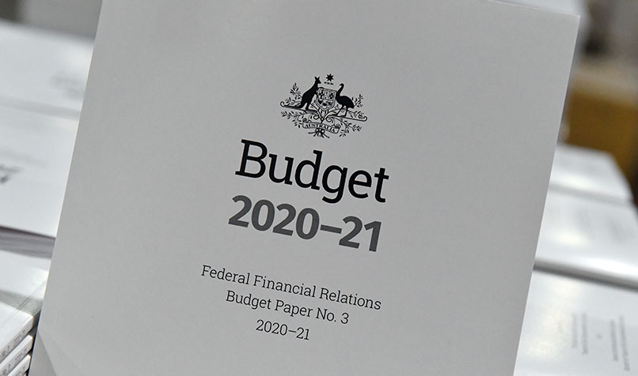
Notes:
WHAT IS THE REAL COST OF A JOB GUARANTEE
Nominal entries in fiscal statements (‘budgets’) are not costs.
Whether it is 10 billion or 100 billion is not indicative.
True costs are the real resources that are used in such a program – food, materials.

Slide 10
Criticisms
What jobs?
Notes:
OTHER CRITICISMS
Coercive.
Neo-liberal mechanism – palliative to capitalism.
Administratively impossible.
Boondoggling – what jobs?
Jobs limited by our imagination

Slide 11
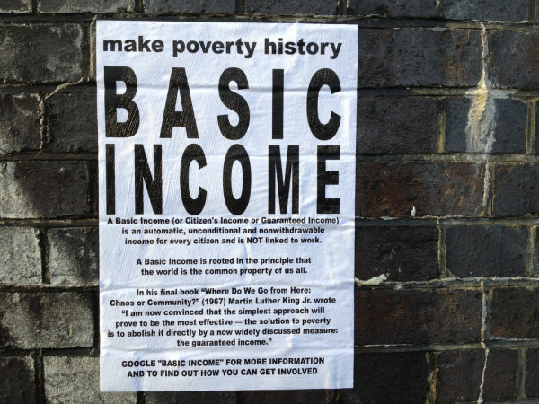
Notes:
WHY NOT A BIG OR A UBI?
UBI proposed as a ‘progressive’ solution to income insecurity, rising poverty and labour underutilisation (including the robot revolution).
Correctly associated poverty with loss of income due to joblessness.
But underlying economics are rooted in neo-liberalism:
No explanation nor solution to chronic unemployment which is cast as being inevitable - lock-step with neo-liberal agenda. SURRENDERS to idea that government cannot create work.
Fails to construct the problem of income insecurity correctly.
Is individualistic - Accords with the neo-liberal bias for individual conceptions and solutions.
No attempt to address the unemployment problem in terms of employment creation but instead offers an individual solution.
Wrongly assumes government is financially constrained. – early studies called for higher taxes on those employed because they have deprived the unemployed of work opportunities by using market forces to to earn above competitive wages – Straight neoclassical economics.
Justified with an elaborate philosophical discussion of justice.
Unemployment – orthodox wage rigidity argument and/or or robots.

Slide 12
No Inflation anchor
Cultural taboo
Passive consumption
Notes:
LIMITS ON BIG
1. INFLATION RISK
No nominal anchor – money for nothing.
Higher the UBI, higher the inflation risk.
So back to an unemployment buffer approach.
2. CULTURAL TABOO
Stigma - money for nothing!
Harder to sell politically – higher taxes.
3, CONCEPTION OF HUMANITY
Payment of BIG - a further withdrawal of State responsibility for well-being.
BIG recipients become passive (consuming) agents.
Being unemployed involves more than income loss - broader form of exclusion from economic, social and cultural life.

Slide 13
I just want to do my art!
Notes:
The COERCION ARGUMENT
BIG advocates say a JG is coercive - we should decouple work from income.
But the BIG just shifts ‘coercion’ of work onto others.
The JG recognises that we all should contribute to society if we can.
Those than cannot are to be supported.
And the JG is based on a fundamental presumption that work is valuable – not only in an income sense.

Slide 14
evolution
Notes:
EVOLVING CONCEPTS OF WORK
What we see as work has evolved over time – but the concept is still confined.
We need to redefine the concept of productivity.
Previously it has been narrowly defined to mean work for private profit.
But we need to consider social benefits and think more broadly.
To achieve social change in attitudes to work it is better to do it “within a work paradigm”.
The JG is thus a short-run palliative and a long-run radical solution – creates a bridge between current social attitudes and broader concepts of work.
How?
Provides framework for re-evaluating what we mean by productive work.
Allows a host of activities that do not support capitalist profit to be considered worthwhile and productive.
Examples – arts community, surfers!

Slide 15
work and identity
Notes:
Work is central to identity and independence.
It is much more than just earning an income.
It is a social construct that gives us a social location.
Persistent unemployment is the central cause of income insecurity.
BIG has superficial appeal, but fails to address macro realities of work, production and consumption and does not achieve sustainable full employment.
Via its local focus, JG can rebuild sense of community as well as purposeful work, and extend the work concept.

Slide 16
END OF TALK

Slide 17
Prior knowledge
The next several slides summarise the economics literature on this topic.
You might find them useful to guide further reading or thought.

Slide 18
Neoclassical theory of unemployment …
Unemployment due to excessive real wages.
Job search – leisure and work.

Slide 19
MMT theory of unemployment …
Firms create jobs if they can sell the output produced.
Unemployment arises when total spending is insufficient.
Systemic lack of jobs – unemployed are powerless to overcome the shortage.
Fiscal deficit too low – relative to non-government spending decisions.
Solution is to stimulate net spending.
Cutting real wages likely to worsen situation – remember the fallacy of composition.

Slide 20
The Phillips curve trade-off
Full employment was initially defined in terms of how many jobs were necessary to meet the desires of the labour force for work.
In the simple aggregate supply story, firms move quantity-adjustment below full capacity to price-adjustment after full employment.
By the 1950s, attention focused on more complete supply story with bottlenecks recognised before full employment.

Slide 21
The Phillips curve trade-off
1958 – Phillips curve enters the picture.
Economic activity (proxied by unemployment rate) directly linked to wage inflation.
At low URs, inflation rises (vice versa).
This led to the Demand Pull theory of inflation.
And the so-called Unemployment-Inflation trade-off was born.

Slide 22
The Phillips curve trade-off
Change in money wages (%)
Social preference function
Point A is preferred trade-off between inflation and unemployment
A
Unemployment Rate (%)

Slide 23
The Conflict theory of inflation
Workers and capital struggle over income shares, mediated by government.
This conflict can trigger a wage-price spiral when the power of workers rises (low unemployment) and they push up wages and firms resist real income losses by restoring markups.
Alternatively a price-wage spiral begins when firms raise mark-ups and workers resist the real income cuts.
So for inflation to result - there must be resistance on both sides.
This type of inflation is sometimes called ‘cost push’.

Slide 24
Raw material price increases
Another cost-push source: oil, food.
Particularly if imported prices rise.
Who will bear the real income loss?
Can lead to inflation if workers or domestic firms try to maintain share (real wage or markup).

Slide 25
Policy accommodation …
Hard to differentiate cost-push and demand-pull in real world.
A cost-push impact on prices is hard to keep going unless demand is high enough to fuel conflict.
It was argued that government (central banks) accommodated the inflation pressure.
Tightening aggregate spending ‘disciplines’ the inflation spiral:
Soft product markets – prevents mark-up push.
Soft labour markets – stops wages pressure.

Slide 26
Post WW2 profit squeeze and inflationary bias
1950-70s period of distributional conflict because workers’ bargaining power grew in strength.
Real wages growth in proportion with productivity growth and wage demands squeezed profit margins.
Firms cut investment, growth slowed.
OPEC oil price rises (1973).
Governments adopted austerity to fight inflation – unemployment rose.
Stagflation allowed Monetarism to take hold.
Keynesian response weak - proposed ineffective wage and price controls.

Slide 27
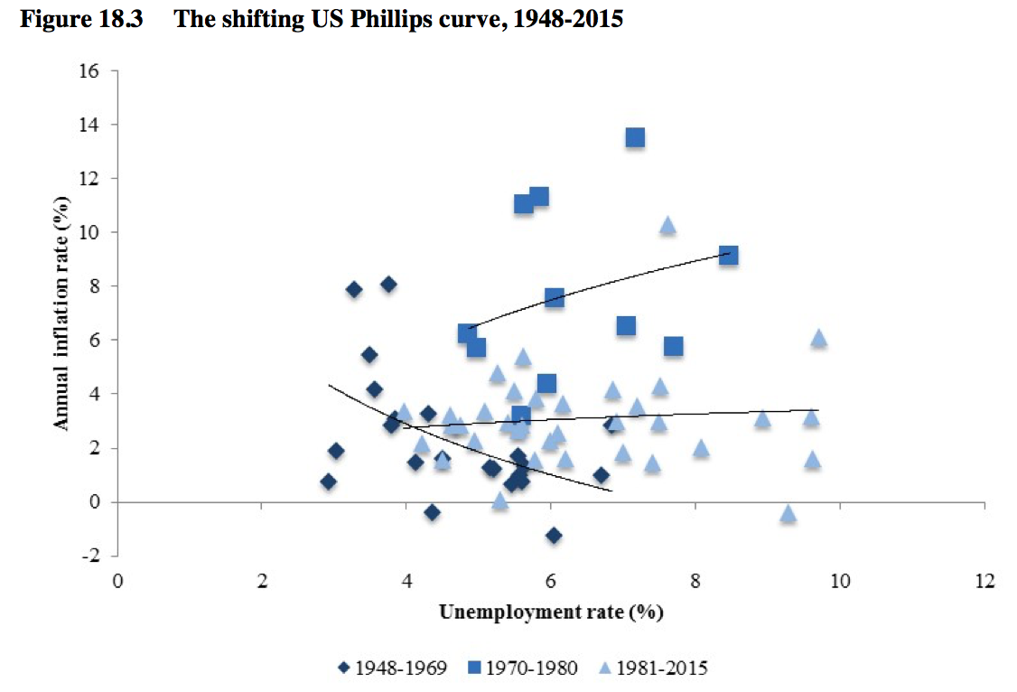
The shifting Phillips Curve …

Slide 28
Emerging Monetarism … Quantity Theory
Considered inflation was due to excessive money chasing too few goods.
Quantity Theory of Money: MV = PY
M is a stock of money.
V is velocity links the stock to the flow of spending.
P is aggregate price level
Y is real GDP.
Assumed full employment and stable V.

Slide 29
Quantity Theory …
Assumed V (habits) and Y (market clearing) constant.
$M\overline{V}=P\overline{Y}$
Then ΔM → ΔP
QED
But economies rarely at full employment.
Velocity is unstable.
Monetarists said if you wanted to control inflation then the central bank had to control the money supply (M).
But central banks cannot control the money supply.

Slide 30
Natural Rate of Unemployment hypothesis …
Monetarists rejected PC trade-off.
Claimed there was only one unique unemployment rate associated with stable inflation – Natural Rate.
Later called the Non-Accelerating Inflation Rate of Unemployment (NAIRU).
This NRU was determined by structural factors in the labour market and could not be manipulated in the long-run by aggregate demand policies.
Attempts to exploit trade-off ended in accelerating inflation.

Slide 31
Expectations and the Phillips Curve …
Monetarists said original Phillips Curve didn’t include inflation expectations.
Inflation could rise independent of state of labour market if expectations were strong.
So a family of Phillips Curve that would rise as inflation rose – because expectations would adjust upwards.

Slide 32
The Expectations-Augmented Phillips curve …
Inflation (%)
LRPC
Adaptive versus Rational Expectations
D
E
4%
B
C
2%
PEX 4%
PEX 2%
NRU
Unemployment Rate (%)

Slide 33
The RATEX evolution …
With adaptive expectations (Friedman), a short-run trade-off was still possible with the consequence of accelerating inflation.
But with rational expectations – where people are assumed to ‘know’ the true economic model and only make random errors – the trade-off disappears and the economy is always on the LRPC at the natural rate.
No space at all for discretionary monetary or fiscal policy.
QED for the anti-government lobby.

Slide 34
Is there are trade-off?
Limited foresight – RATEX impossible.
Institutional lags in wage setting.
How steep is the Phillips curve?
Rise of part-time workers – the ’precariat’.
Diminishing trade union power.
Rise of underemployment.
Incomes policies.
Hysteresis – hiring standards shift over cycle.

Slide 35
What is inflation?
Inflation: a continuous rise in the aggregate price level.
Accelerating (decelerating) inflation: inflation rises (falls).
Deflation: aggregate price level falling.
Hyperinflation: extreme case of accelerating inflation
Inflation sometimes classified as cost-push or demand-pull.

